Slide 1
Computer Components
Module 1
Part 3

Slide 2
Computers are ubiquitous
Almost all devices you own have at least a small computer built in.
Your laptop/computer and phone/watch are obvious
Your car, tv, microwave, fridge, smart devices are maybe less obvious.
All these have parts in common.
We are going to look at the parts of a computer, or computing device.
These are the physical (hardware) parts. There is a separate discussion to talk about software.

Slide 3
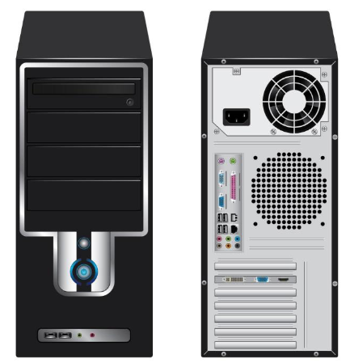
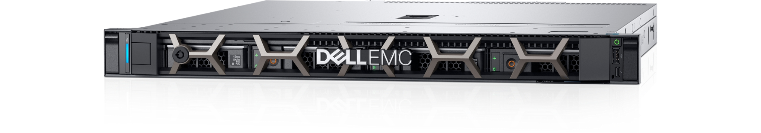
Cases
Typically, computers are in a case.
Laptops
The case is the device you are used to holding
Phones
The case is what you hold
Desktop Computers
Look like the picture to the right →
Servers

Slide 4
Purpose of the case
Protect the internal components.
Most components are delicate/fragile
Most are sensitive to moisture and static electricity
Help with cooling
Typically, cases provide cooling
Active cooling means fans, or water cooling
Passive cooling means heatsinks or other means to get rid of heat

Slide 5
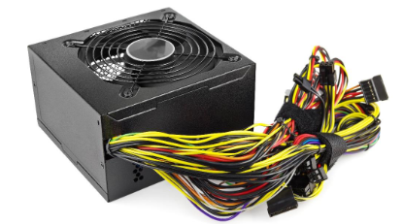
Desktop/Server Power Supply
Converts AC Power to +3v, +5v, +12v and -12v
Different parts of the computer use different voltages
Each has a specific connector

Slide 6
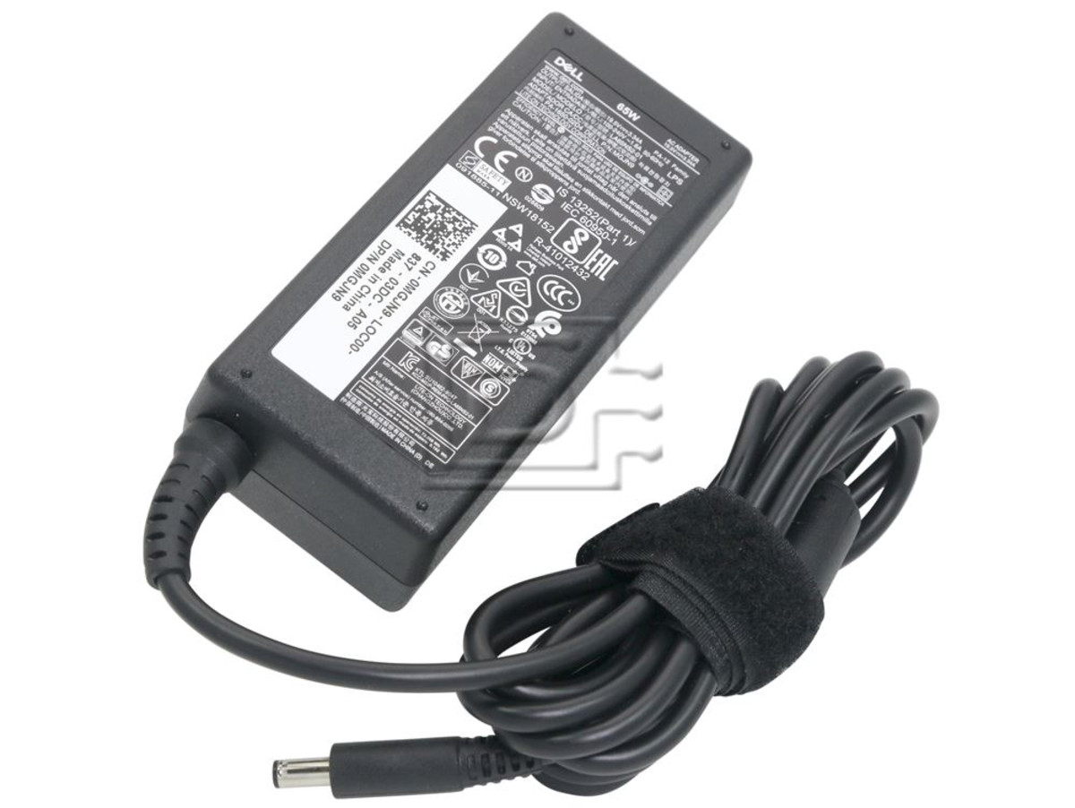
Laptop/Phones Power Supply
Typically, laptops have power bricks
Many modern laptops use a standard USB connector to supply power
Can run at different power:
5v (10W)
12v (36W)
20v (100W)
Watt = Volt * Amps
Phones mostly use USB-C now as well.
Other laptop brands use proprietary

Slide 7
CPU - Central Processing Unit
Typical CPUs are:
Intel
AMD
Arm
CPUs are often made up of parts:
ALU (Arithmetic Logic Unit)
Control Unit
Registers
Cache
Clock

Slide 8
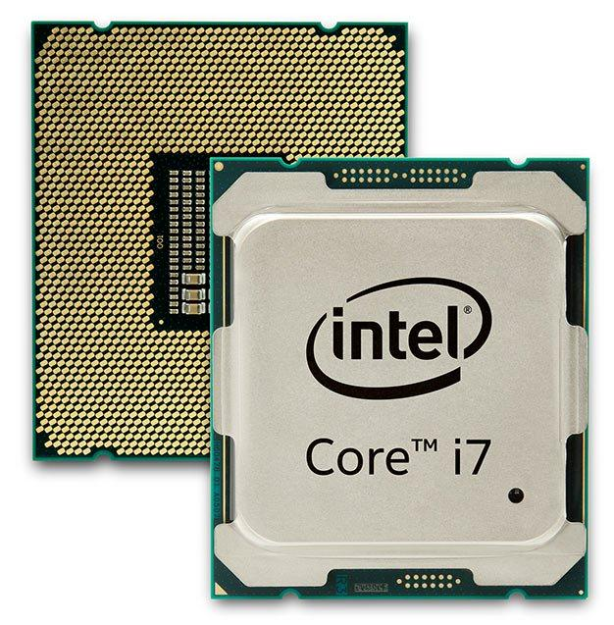
CPUs have lots of pins
These pins connect to the motherboard
Pins are used to communicate with the CPU.
Turning on power on certain pins tells the CPU what instruction you want it to execute
Other pins are used to receive answers from the CPU

Slide 9
Arithmetic Logic Unit
Intel and AMD have large instruction sets they have hundreds of instructions the CPU can perform.
e.g.: Arithmetic operations (add, subtract, … etc.)
The ALU is responsible for most calculations
How do them work?
We’ll look at binary numbers and logic gates soon.

Slide 10
Cores and speed
Each CPU operates at a particular clock speed.
You may have a 3.2Ghz CPU, which means its clock runs at 3,200,000,000 ticks per second.
A CPU can generally do one operation per tick of the clock. So, a 3.2Ghz CPU can perform 3.2 billion additions per second.
Additionally modern CPUs often have multiple cores. Each core acts as an independent CPU. Thus a 4 core CPU that runs at 3.2Ghz can do 4x3.2 billion additions per second

Slide 11
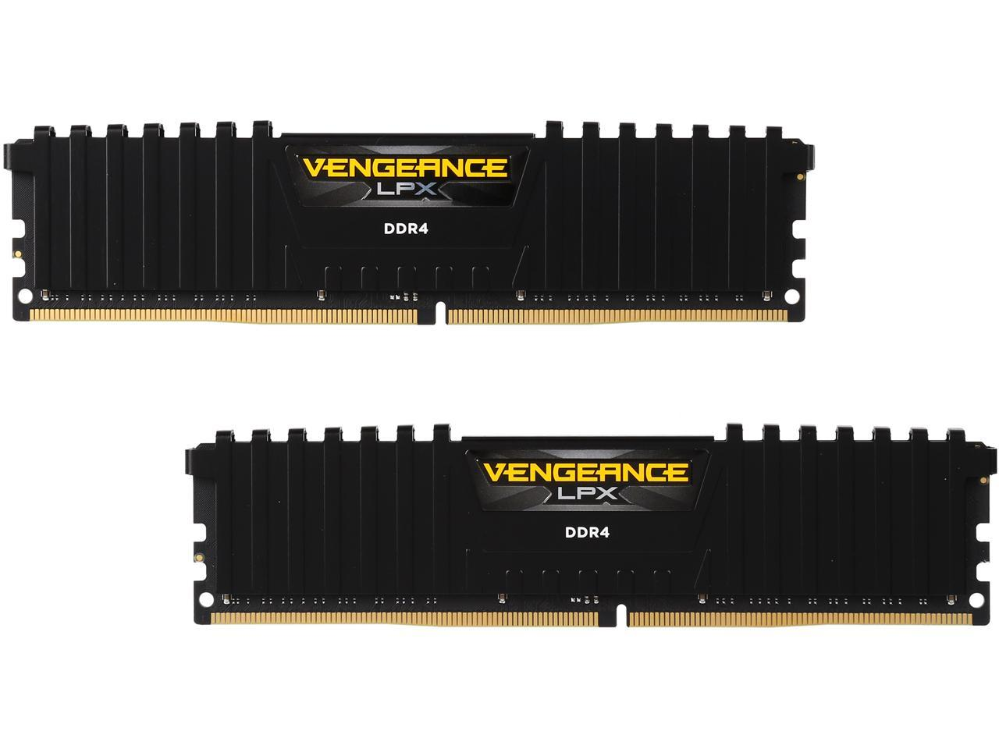
RAM - Random Access Memory
RAM is where the computer holds information while it’s booted.
Think of it this way: It’s how much the computer can think about at once.
Typically, 4GB, 8GB, 16GB, 32GB
Each application you open (e.g.: Chrome/Safari uses some amount of RAM while you are using it)

Slide 12
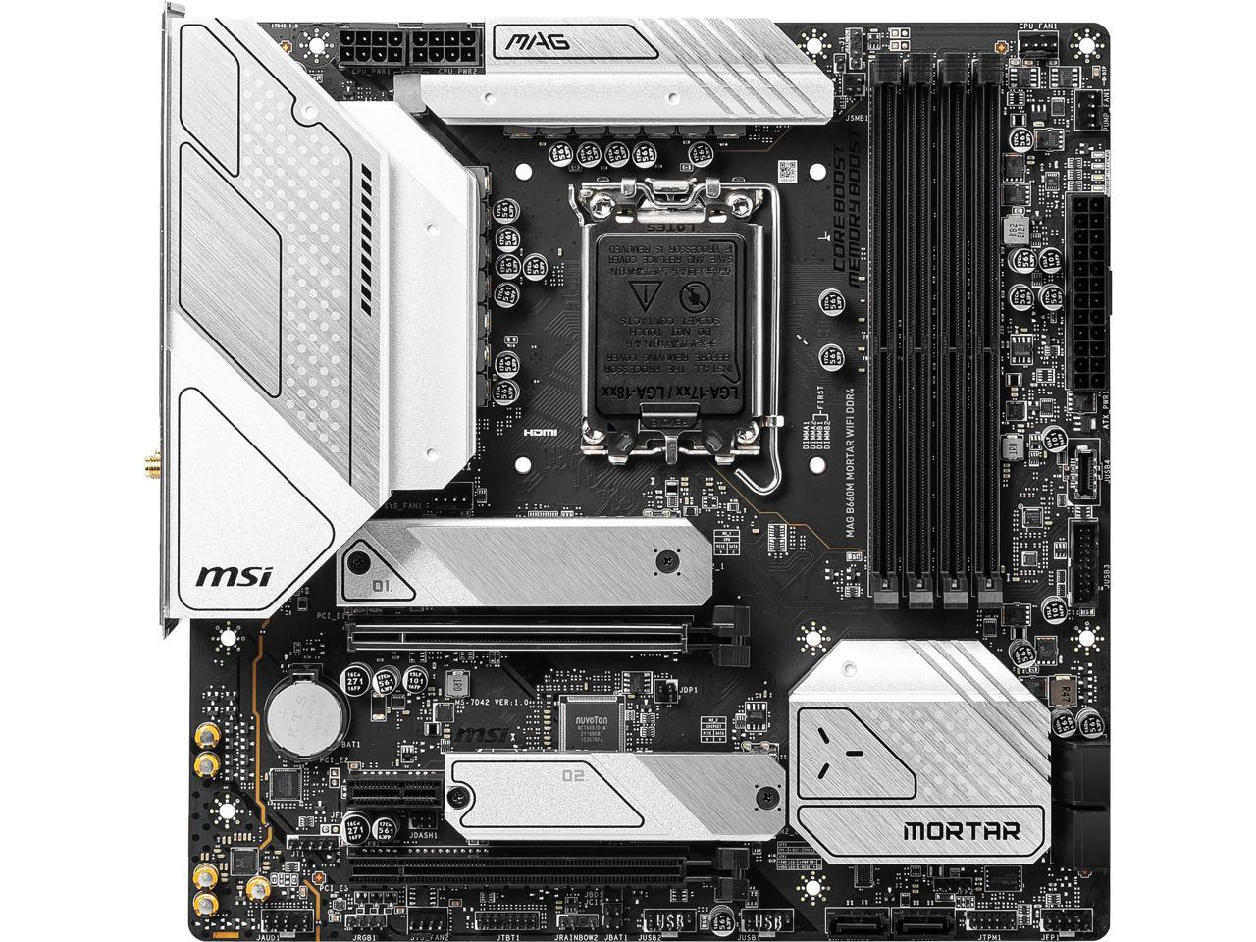
Motherboard
Most of the components in a computer plug into a main board called a motherboard.
It’s responsible for moving information from one device to the next

Slide 13
GPU - Graphics Processing Unit
Drawing games, rendering video, doing 3D modeling all requires the computer to be able to draw things.
Computer graphics involve a lot of math.
Matrix math is used a lot to calculate how objects move on the screen
As such, there are operations that you have to do over and over. While they can be done on the CPU, it would be better if you had specialized hardware that’s dedicated to these types of operations
Introducing graphics cards

Slide 14
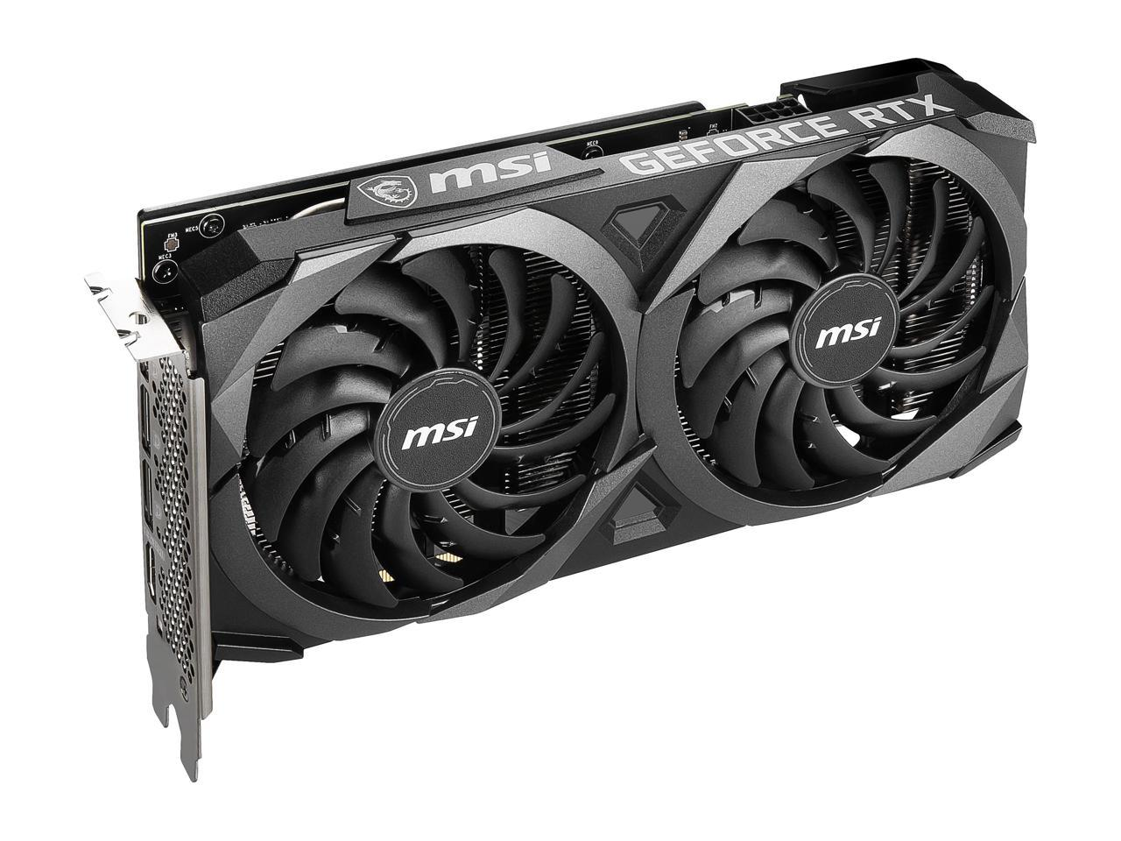
Graphics Cards
Pretty much all computers have a GPU, sometimes it’s built into the CPU, sometimes it’s a separate card.
These cards typically have ports to connector monitors on the side
They often have lots of fans to keep them cool
Due to their specialized math capabilities, they are also useful for various cryptographic problems.

Slide 15
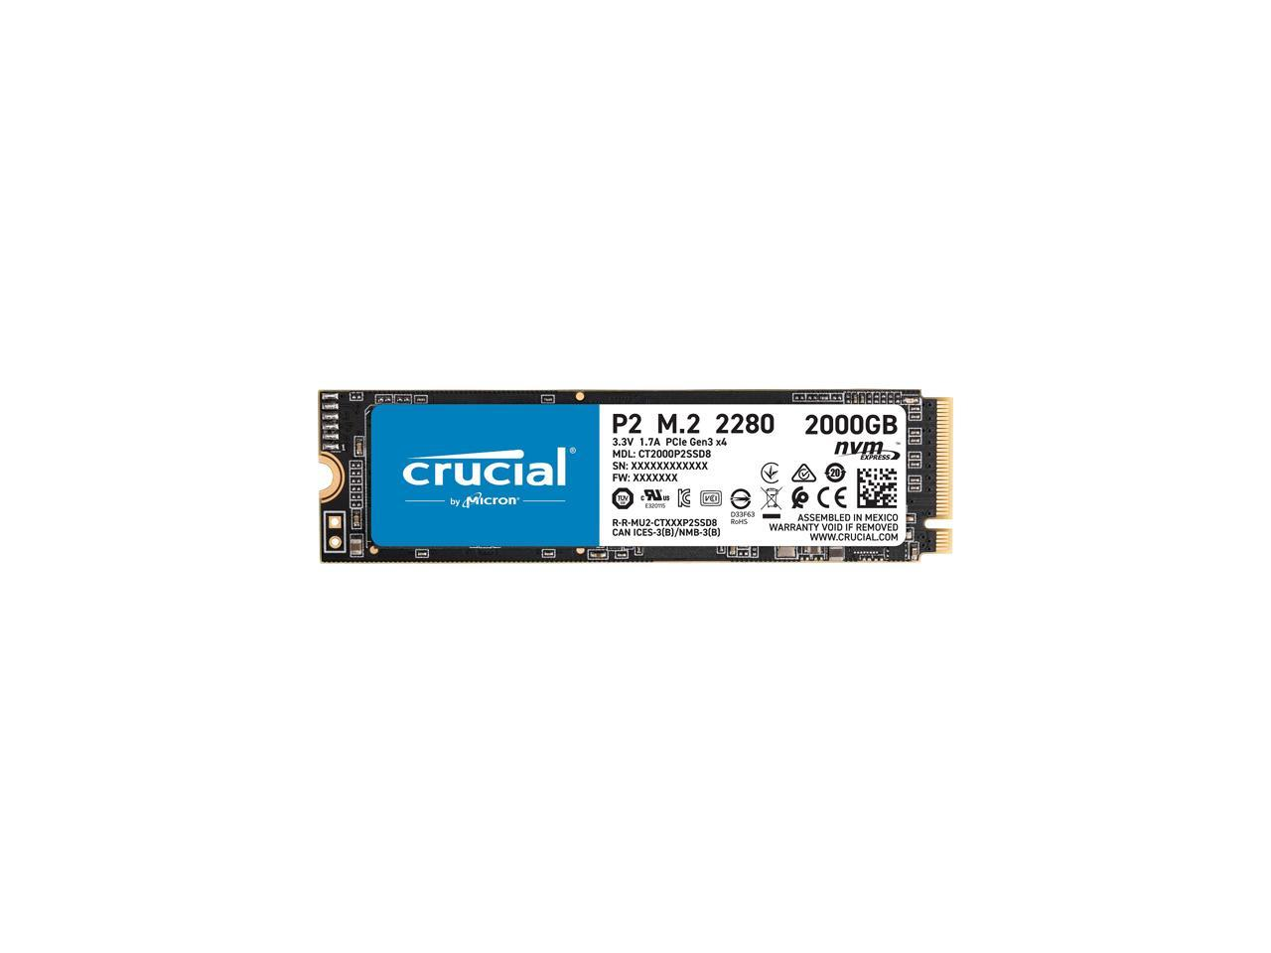
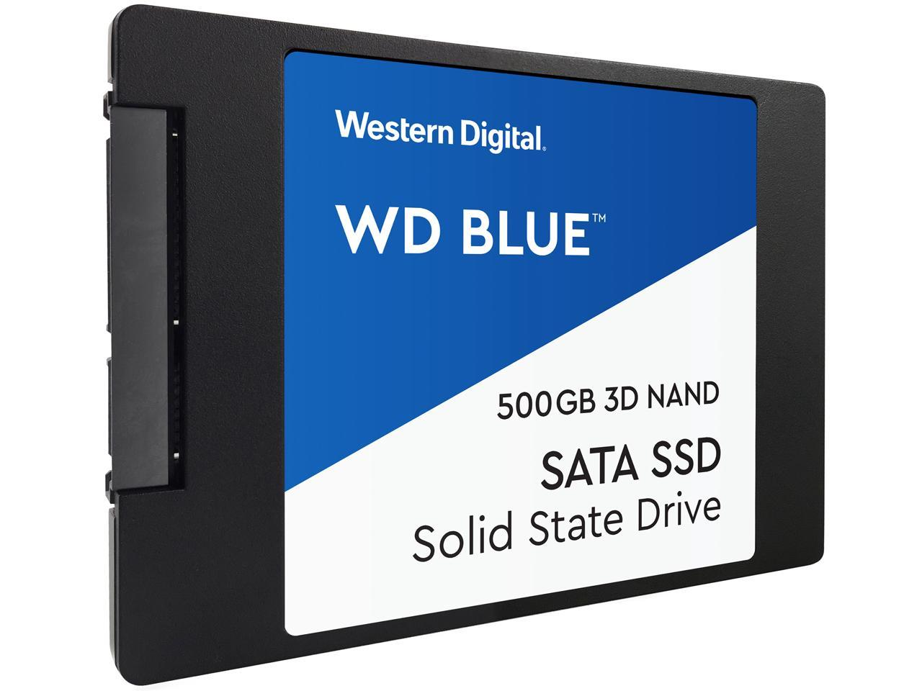
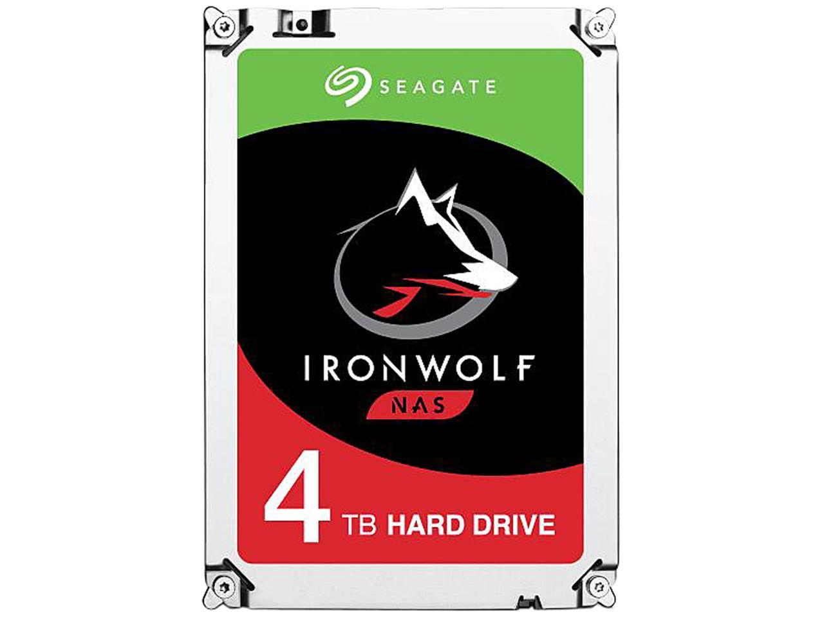
Storage Devices
Hold information while the computer is off
This is where all your documents, games and other stuff is stored.
Typically, sizes are in TB
Old style Hard Disk Drive
More modern SSD or NVMe

Slide 16
Additional parts
Depending on the needs of the computer, there can be other cards or chips added:
Battery (Internal in Phones/Laptops, UPS etc.)
Network cards (Ethernet, Wifi, 4G/5G etc)
GPS, NFC, Bluetooth
Sound cards (high definition audio, DAC etc.)
Connectivity ports (USB, Serial, Specialized)
Cameras, Microphones, Sensors (gyroscopes, temp, heartbeat, speed, acceleration etc.)
Raid Cards (make more redundant storage)
Optical Drives

Slide 17
Heat
There are a few places that produce heat in your computer.
Power supply
Converts AC power to DC power, this causes heat (lots of heat).
CPU (Central Processing Unit)
Power flows through CPU in many many paths. Each path encounters resistance and causes heat.
GPU (Graphics Processing Unit - Graphics Card)
Again, lots of paths with resistance.

Slide 18
Overheating
If components in your computer get too hot, they can be damaged.
Thus, a big part of computer design is getting rid of heat
Fans are noisy, but effective
Heatsinks are silent, but large
The case material in phones are often chosen to help dissipate heat

Slide 19
Cables
All computers have a power cord.
Typically, 110v AC in the case of desktops
Typically, some voltage of DC in the case of phones, tablets, laptops
Some use wireless charging
Many devices plug in via USB (Universal Serial Bus)
Keyboards, Mice, Printers, Scanners, Headphones, Cameras, Mics, Flash Drives, Game Controllers, Decorations (LED Lights), even sometimes monitors

Slide 20
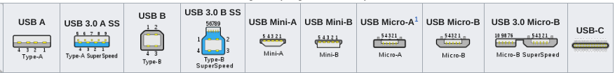
USB
Designed to simplify peripherals so everyone uses the same standard, USB has become ubiquitous
Physically there are many different USB plugs.
Wikipedia has this chart:
Today USB-C is the standard that everyone should be moving towards, however lots of older equipment still uses A and B.

Slide 21
USB can do many things
Provide power
Many laptops, tablets and phones charge of USB-C now
Lights, fans, and many decorations can be powered of USB
Send and receive any type of data
Audio, Video, Control signals for just about any device.

Slide 22
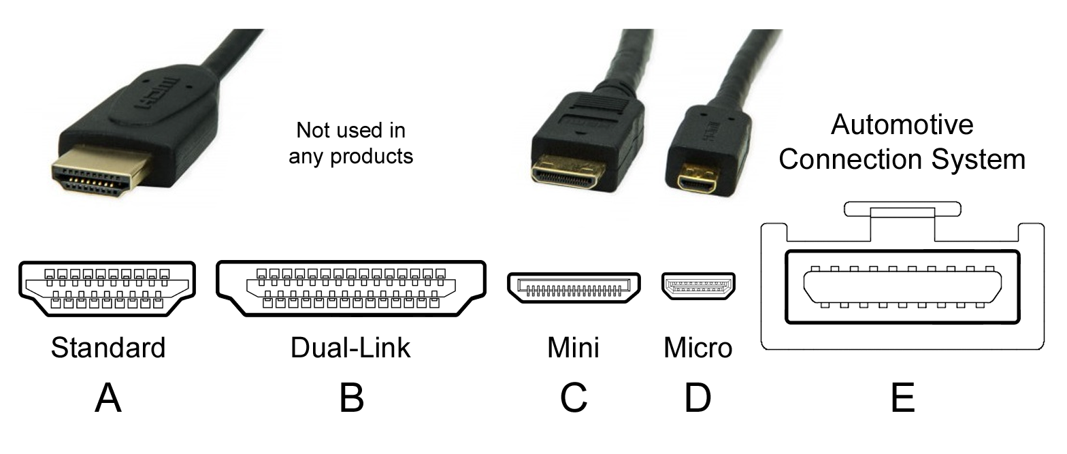
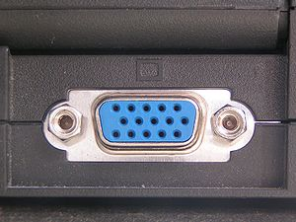
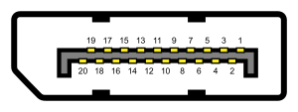
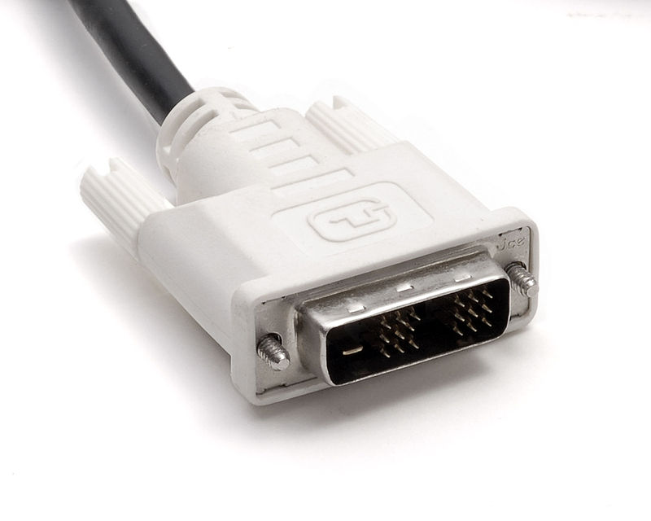
Hooking up displays
Monitors can be connected to computers in a variety of ways:
Internal (typical for phones, laptops etc)
External:
HDMI DVI Display Port VGA

Slide 23
Computer Networking
While stand alone computers can do amazing things, once you connect many computers together you can do incredible things.
Computers can be connected to neighbouring computers (LAN)
And they can be connected to computers far away (WAN).

Slide 24
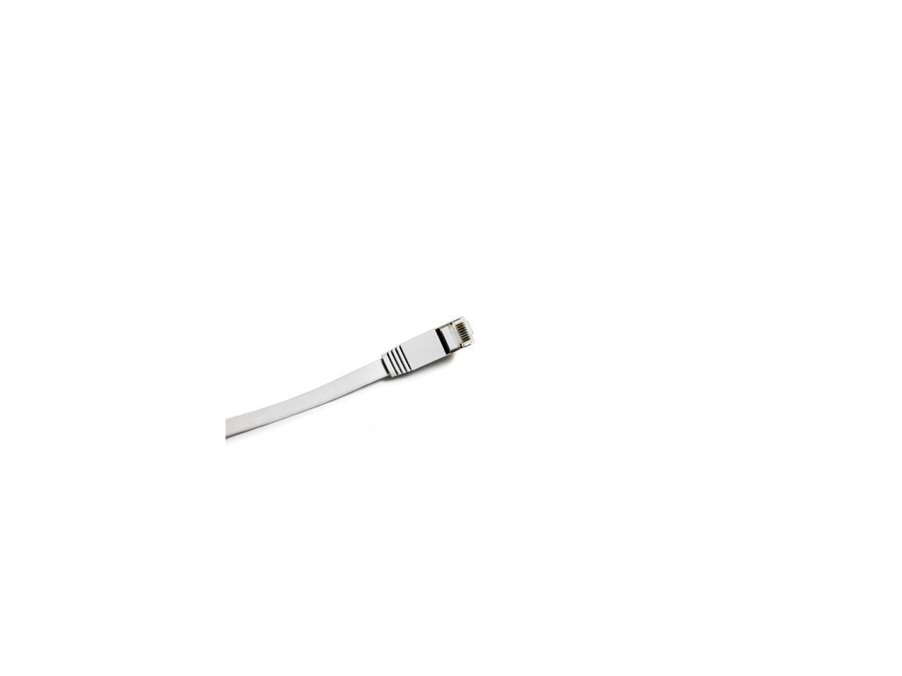
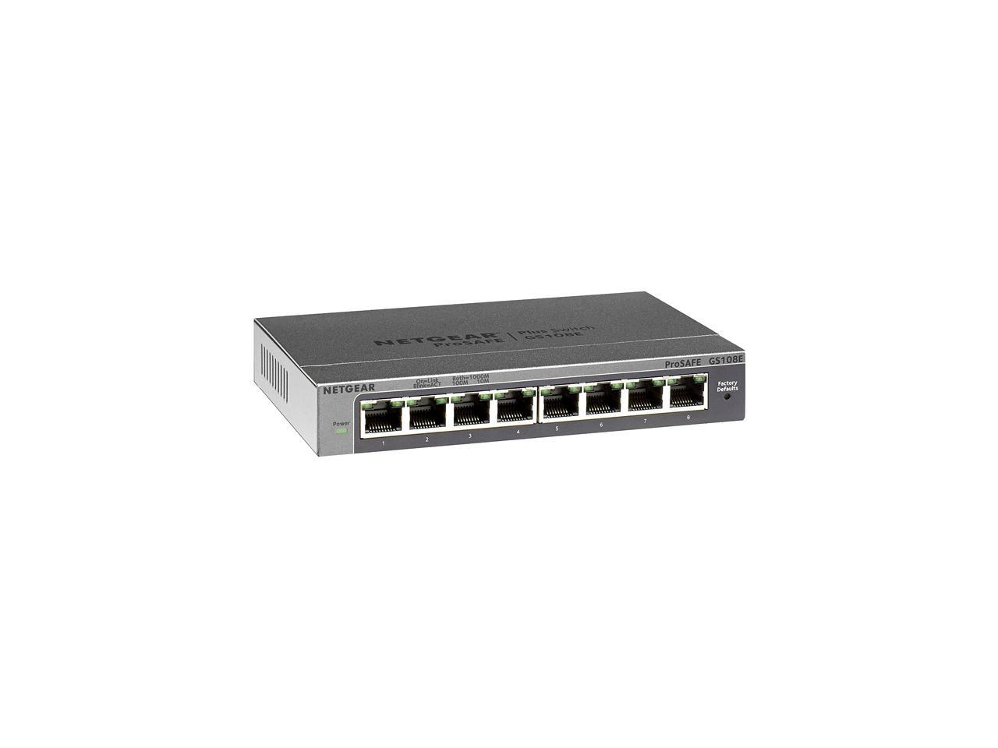
Local Connections
Most computer are connected to their neighbours via either wifi, or an ethernet cable
Ethernet cable is often referred to as cat5, cat5e, cat6, cat7
These standards specify max speed
Ethernet cables are typically plugged into a switch

Slide 25
IP address
Each computer has an IP address.
e.g.: 10.0.0.1
When one computer wishes to speak to another it creates “packets” of data, which have the address they are destined for at the top of the packet
The network switch knows which physical port a given computer is plugged into, so it knows to send the packets to a particular port/cable to get it to the destination.
IP addresses must be unique
Unless they are NATed

Slide 26
More than one switch
A large building such as the Atrium building, may have 10, 20 of more switches
Each switch has an “uplink” to another switch. Often one switch is a central switch, and all the other switches hang off it.
Each of those switches may have 8, 16, 32, 64 or more computers connected to it.
This pattern can be repeated to connect thousands of computers together.

Slide 27
Wireless works the same way
On the ceiling of most rooms in the university, there are access Wifi access points.
When a computer is in range of the access point, it can authenticate (username/password) to the access point and be given an IP address.
That access point is plugged into switches just like other computers.
Now computers on wireless networks can talk to computers that are physically wired.

Slide 28
Connecting to the internet
One switch in your LAN connects to your internet connection.
Internet connection is typically a fiber, coax, or ethernet line, via a router.
Your Internet Service Provider (ISP) provides you service up to this router.
ISPs are like giant LANs. They connect buildings of people together via their own high-level switches.
They also connect to other ISPs to allow you to talk to other networks.

Slide 29
Routing
So how does your computer download information from let’s say wikipedia?
Wikipedia has servers which hosts the data
They pay an ISP to connect their servers to the internet
You pay an ISP to connect to the internet.
While your ISP is likely different from Wikipedia’s ISP, they are connected together via multiple other ISPs.

Slide 30
Fiber
ISPs typically connect to each other with fiber optic cable.
Fiber optics are a glass hollow cable, that light can reflect inside.
A laser is pulsed in a specific way to transmit data along the cable.
Fiber can go very long distances without losing signal.

Slide 31
Internet protocols
DNS - Domain Name System
Converts names (e.g. kennesaw.edu into IPs, and vice versa)
HTTP/HTTPS
Retrieves web pages, videos, images, sounds from the internet for your web browser
Each resource has a Universal Resource Locator (URL)
Many others
Email: smtp, pop, imap, remote desktop, database servers etc.

Slide 32
Interesting
In a command prompt:
ping www.google.com
Notice it’ll show you the IP address of the google server you are talking to
It’ll show you have long it took to get from your computer to google
This tool is useful to ensure a server is on the network.
However, not all servers are configured to reply to ping to prevent DDOS attacks.

Slide 33
Questions?
Note in this presentation are all from:
Wikipedia, dell.com or newegg.com

