Slide 1
CSE 1300
Internet / Networking
Notes:
Introduce yourself and welcome the students

Slide 2
What Is Networking?
﻿Networking is the exchange of information or services among individuals, groups, or institutions
﻿﻿Networks are used almost everywhere. Without them you would not have the internet or be able to log in to the computers at school/work. Many tasks that you use a computer for would become almost impossible

Slide 3
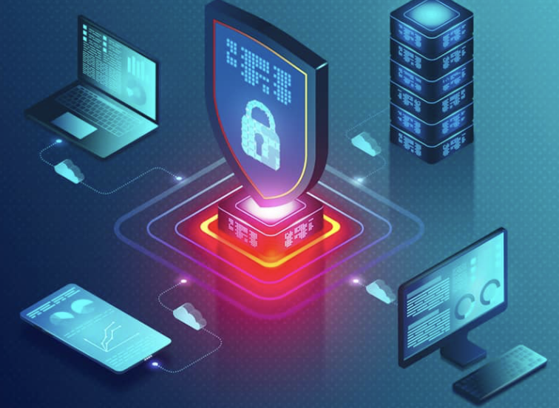
What Is a Network Device?
An item that use networks or have internet access.
Example: Computers, cell phones, and gaming consoles.

Slide 4
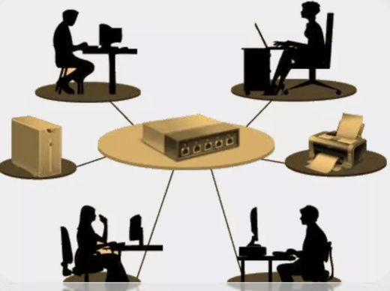
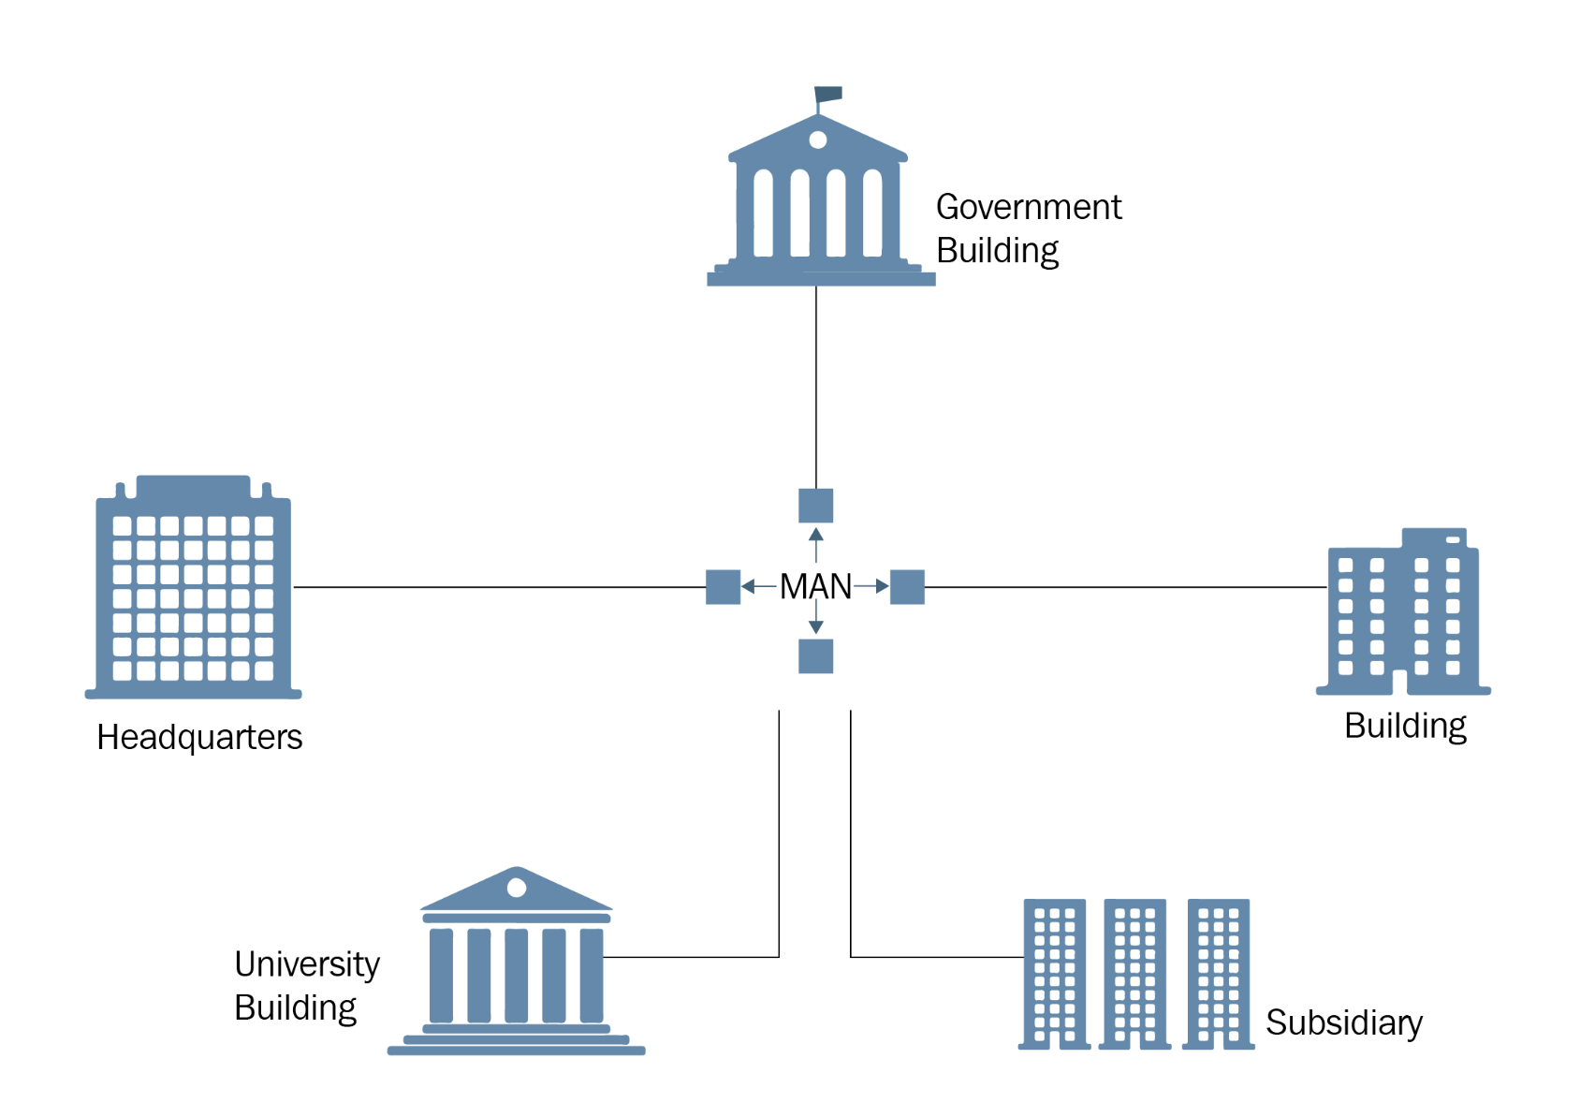
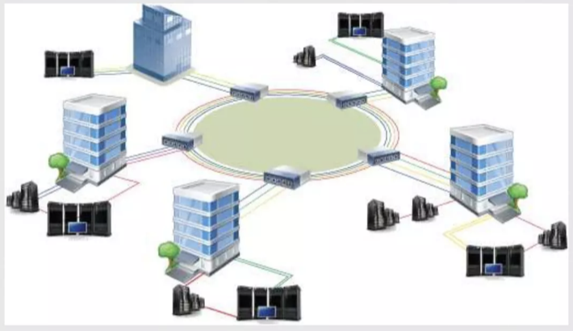
NETWORK TYPES
﻿LAN (Local Area Network) gives of group of computers in close proximity to each other the ability to share resources like files, printers, games and other applications. Can be physically wired or wifi
MAN (﻿﻿Metropolitan Area Network) is a network that interconnects users with computer resources in a geographic area or region such as a town or university.
﻿WAN (Wide Area Network) spans a large geographic area, such as a state, province or country. WANs often connect multiple smaller networks, such as local area networks (LANs) or metro area networks (MANs).
  The world's most popular WAN is the Internet.

Slide 5
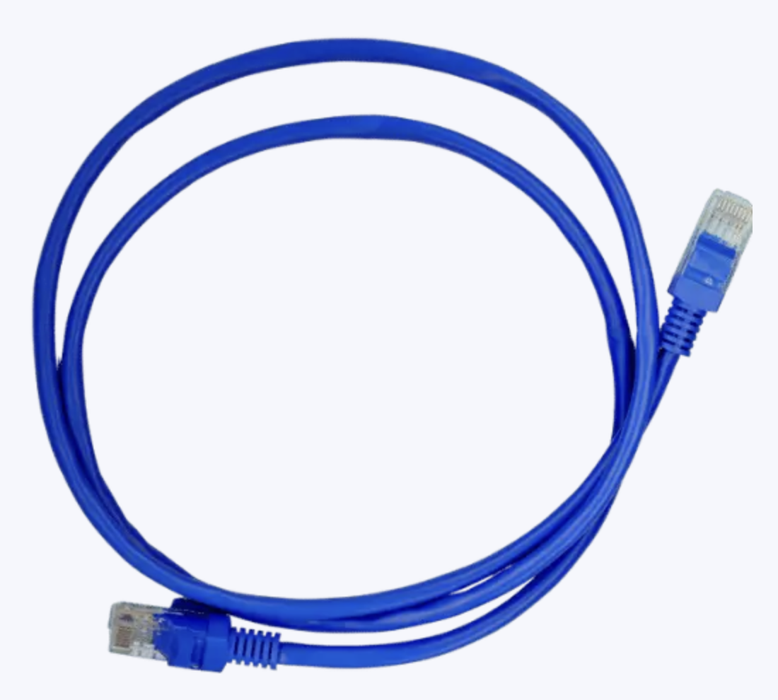
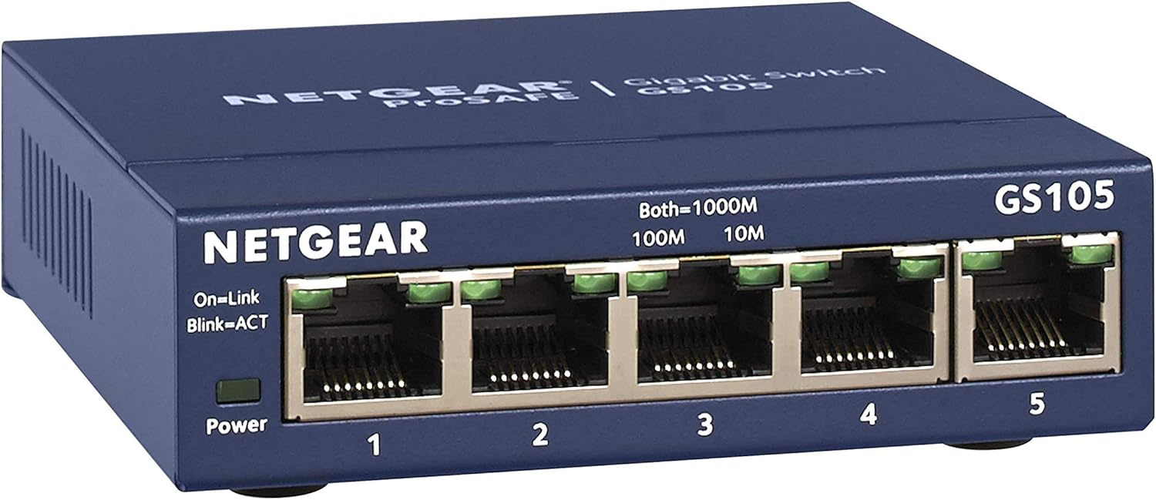
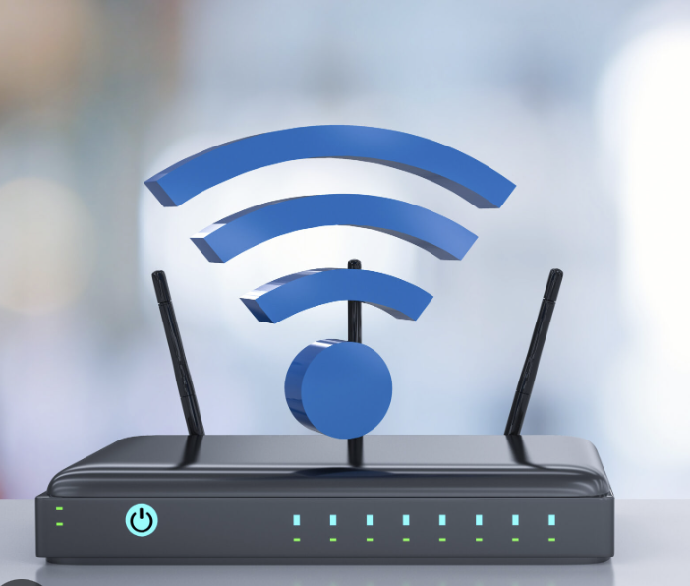
Connection types
Connections from your computer to your LAN are typically done with either:
  An ethernet cable (Cat 5e, 6 or 7)
    Modern networks typically operate at 1Gb/s
    Network cables connect into switches
  Wifi (802.11)
    Different standards support different speed (1, b, g, n, ac, ax, be, bn…)
    Modern standards support up to 1Gb/s.
    Note the max speed is theoretical, typically you’ll get much less in practice due to congestion, interference, and hardware limitations.
    Requires an “access point” which is typically physically wired with an ethernet cable to the LAN.

Slide 6
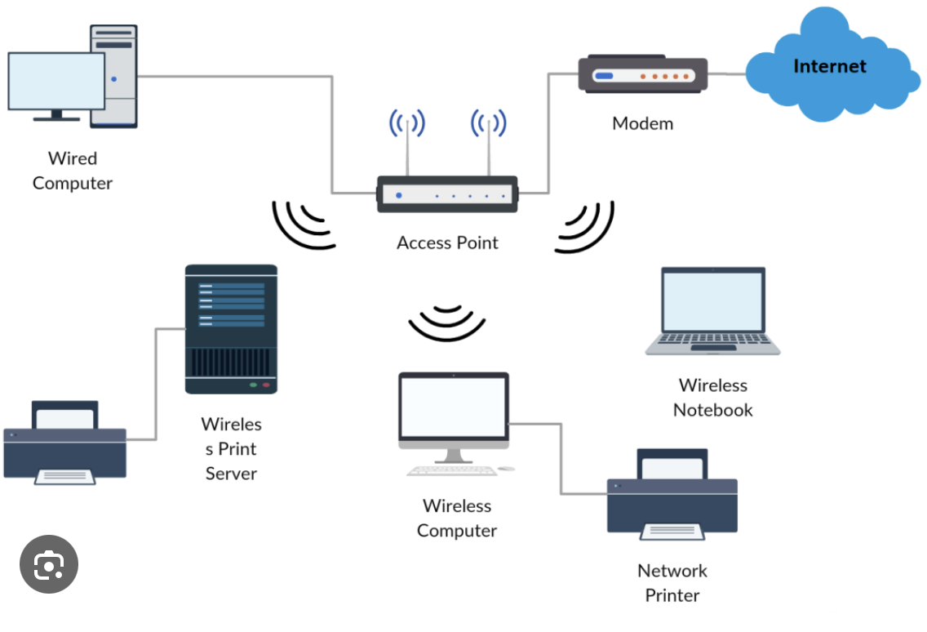
Wifi networks
﻿Wireless communication from your Wi-Fi card in your computer to the access point.
The access point can communicate with many different clients simultaneously.
Different frequencies are used to avoid interference from neighboring Wi-Fi networks.
  The access point and clients do this automatically.
Each access point covers a physical area, when you move your connection is handed from one access point to the next.

Slide 7

Basic Components of Networking
Clients (Computers, Laptops, Tablets, Phones, Servers) connect:
  To Network switches
  Access Points via wifi which in turn plug into network switches
Network switches connect to other network switches via either Cat 5e cables, or Fiber cables
Eventually switches plug into network routers. These are devices that connect LANs together, as well as to WANs.
Routers find out about each other on the internet via protocols such as BGP and OSPF.
This building at KSU has wireless access points on the ceilings which you can connect to. Those access points are connected via Cat5e cables to network switches in networking rooms around the building. The networking rooms are connected to eachother and eventually to the building router, which sends traffic from this building to other buildings and the internet.

Slide 8
Firewalls
﻿A firewall can be implemented in either software or hardware.
The purpose of a firewall is to restrict traffic flow to only desirable hosts.
A set of rules are established which specify which computers are permitted to speak to which other computers.
Firewalls are instrumental in securing your network.
Your home router that your ISP gave you likely has access rules or firewall rules you can use. Typically the default rule is to deny all inbound traffic, and permit all outbound traffic from your house.

Slide 9
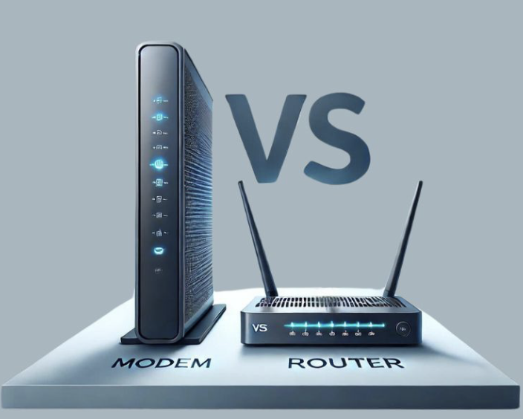
MODEM
A modem is a device which is typically used to change the type of link.
Common examples:
  If your house uses DSL, you have a DSL modem
  If your house uses Cable Internet, you likely have a cable modem
  If your house uses Fiber internet, you likely have a fiber modem.
They convert from your LAN to a single which can be sent over the new medium.

Slide 10
Understanding IP Addresses
When you speak to a room full of people, you will start with “Hey Jack…” to specify who you are speaking to.
Computer networks are similar, hundreds of devices may be connected, so it’s important to specify which device a message is for. This is done with IP addresses.
Each device is assigned a unique IP address in the network.
  Most networks today use IPv4 addresses such as 10.0.0.1.
  Each IP is made up of 4 “octets”. Each octet is a number between 0 and 255.
    The lowest address is 0.0.0.0, the highest is 255.255.255.255.
  Some networks have moved to IPv6 addresses such as 1234:5678:9123:4567:aaaa:bbbb:cccc:dddd
    8x 16bit hexadecimal numbers are separated by colons.

Slide 11
IPv4 vs. IPv6
IPv4: 32-bit address, ~4.3 billion unique addresses (e.g., 192.168.1.1).
IPv6: 128-bit address, nearly unlimited addresses (e.g., 2001:0db8:85a3::8a2e:0370:7334).
Reason for Migration:
  Exhaustion of IPv4 addresses and need for more devices.
  More devices are connecting to the internet. Some lightbulbs connect with their own IP address. Your watch, your phone, your laptop, your smart ring, your headphones all may have IP addresses.

Slide 12
Public vs. Private IP Addresses
Public IP: Routable over the Internet; assigned by ISPs.
Private IP: Used in LANs (Local Area Networks); not routable on the public Internet.
Address Ranges: Private IP ranges (e.g., 192.168.x.x, 10.x.x.x, 172.16.x.x–172.31.x.x).
  These can be reused in hundreds of networks but require at least one public IP address to connect to the internet.
  Your home likely uses one of these ranges, and all data coming from your network shares a single public IP assigned by your ISP.

Slide 13
Networking Protocol Layers (OSI/TCP-IP Models)
OSI Model (7 layers): Physical, Data Link, Network, Transport, Session, Presentation, Application.
TCP/IP Model (4 layers): Link, Internet, Transport, Application.
Purpose: Standardize communication functions into distinct layers.

Slide 14
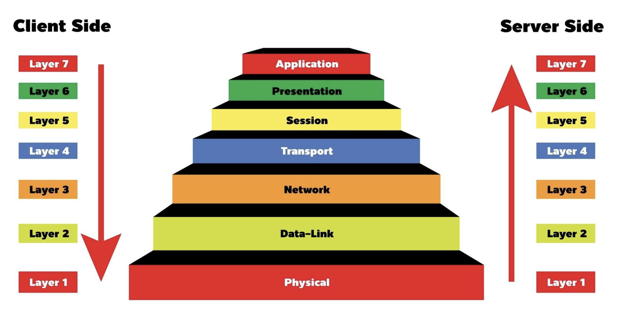

Slide 15
ISP - Internet Service Provider
﻿﻿﻿Refers to a company that provides Internet services, including personal and business access to the Internet
﻿﻿Examples:
Xfinity
﻿﻿AT&T
﻿﻿Time Warner
﻿﻿Verizon

Slide 16
IP – Internet Protocol
﻿﻿A set of standard protocols used for almost all communication on the internet.
  Contains protocols like TCP, UDP, ICMP, etc.
Defines the IP address standards.
Is widely extensible which is why it’s still used today despite the speed and scale of the internet changing rapidly since inception.

Slide 17
DNS – Domain name system
﻿﻿﻿While every computer on the internet as an IP address, humans are not good at remembering 74.125.138.102. We are much better at remembering “google.com”.
  DNS is a protocol which allows us to convert names (Domain names) that are easy to remember into IP addresses.
  When you type in Kennesaw.edu into a web browser (chrome, firefox, safari etc), the first thing which happens is that it’s converted to an IP (172.27.130.29).
  You can do a DNS lookup on any computer by typing in a command/prompt:
    nslookup kennesaw.edu

Slide 18
TCP - Transmission Control Protocol
TCP is used by most services on the internet.
  HTTP/HTTPS – Most of what you know as the internet uses HTTP. It’s how all web pages are retrieved in Chrome, Firefox, Safari, Edge etc. Also used for most apps on your phone.
  SMTP – How all email is transmitted from one server to another.
  Many others (DB connections, monitoring systems, etc)
TCP starts with a handshake between the 2 communicating parties.
  E.g. your phone wishes to get the latest updates from Instagram.
  Your phone first finds the IP address of an Instagram server via a DNS lookup.
  Next your phone establishes a TCP connection to port 443 on the instragram server.
  Your phone and the server negotiate what encryption they will use, and select a random encryption key.
  Your phone requests the feed.
  The server sends the current feed, then disconnects the TCP session.

Slide 19
Packets
Much like how humans speak in sentences and pause between them, computers speak in packets.
  The size of the packet varies depending on the media (wireless, wired) which the packet is being transmitted over.
  Each packet is transmitted separately from the sender to the receiver.
    It’s possible 2 packets in the same connection may take different routes across the internet.
  In TCP each packet contains data as well as some header information which can be used to ensure the data didn’t get corrupted along the way.
    If the packet is bad, the receiver can tell, and will reject (NACK) the packet. The sender will then retransmit the same packet in the hope that it gets there safely the next time.
    If the packet is good, the receiver will acknowledge receipt (ACK)

Slide 20
UDP
User Datagram Protocol (UDP):
  Connectionless, faster but no guarantee of delivery (e.g., video streaming, online gaming, DNS).
  Imagine having a phone conversation, if the person on the other end doesn’t hear one word you said, they typically won’t ask you to repeat it, they’ll figure it out from context and move on.
    UDP works the same way
    For video, video games, it usually is more important to have the most receive information rather than going back and correcting something from a while ago.
      E.g. in a video game if you are at position 2,3 and then you are suddenly in position 5,3, the chances are you moved 2,3 -> 3,3 -> 4,3 -> 5,3. Since we know you are now in 5,3, just move the character to 5,3 and don’t worry about how we got here.
  Trade-Off: Reliability vs. speed.

Slide 21
HTTP vs. HTTPS
Hypertext Transfer Protocol (HTTP): Foundation of data communication for the web (port 80).
Hypertext Transfer Protocol Secure (HTTPS): Encrypts data using SSL/TLS (port 443).
Benefits of HTTPS: Security (confidentiality and integrity) for online transactions, logins, etc.

Slide 22
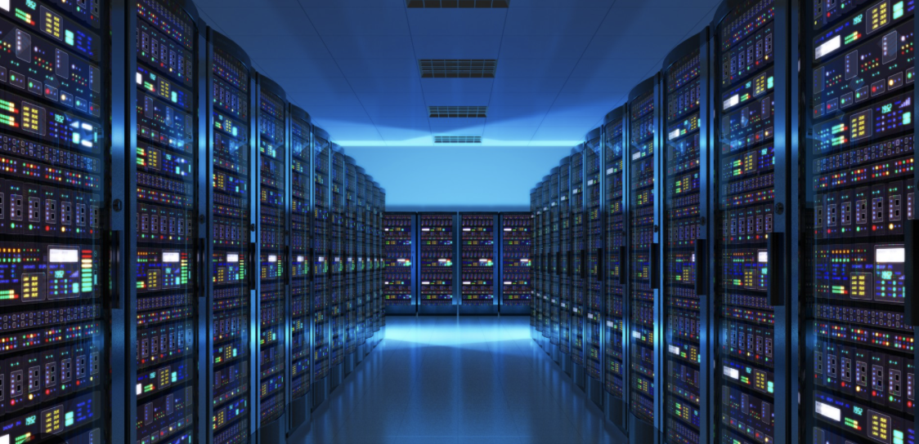
SERVER
﻿A server is a computer in a central location that runs software or stores data.
﻿﻿Multiple clients can connect to the server for their processing needs

Slide 23
Domain Name System (DNS)
Companies, organizations and individuals can purchase Domain names (oversees kennesaw.edu) from domain registrars
  Most sites use .com (company). But there are many high level domains (.net, .gov, .uk etc)
  Each high level domain is owned by one registrar who manages it and creates DNS servers that serve those records.
  Purchasing a domain name can cost anywhere from $7 to thousands depending on how desirable it is. Shorter names are more desirable.
ICANN (Internet Corporation for Assigned Names and Numbers) is in charge of the whole system.

Slide 24
Network Security Considerations
Threats: DDoS attacks, phishing, malware, man-in-the-middle attacks.
Mitigation: Firewalls, intrusion detection/prevention (IDS/IPS), encryption, frequent patching.
Zero Trust Model: “Never trust, always verify” approach to network access.

Slide 25
Future Trends in Networking
5G and 6G: Higher speeds, lower latency, more IoT possibilities.
Software-Defined Networking (SDN): Centralized, programmable network management.
Edge Computing: Processing data closer to the source to reduce latency.
IPv6 Adoption: Continued growth to accommodate more connected devices.

