Slide 1
CSE1300
Controlling Hardware
Notes:
Introduce yourself and welcome the students

Slide 2
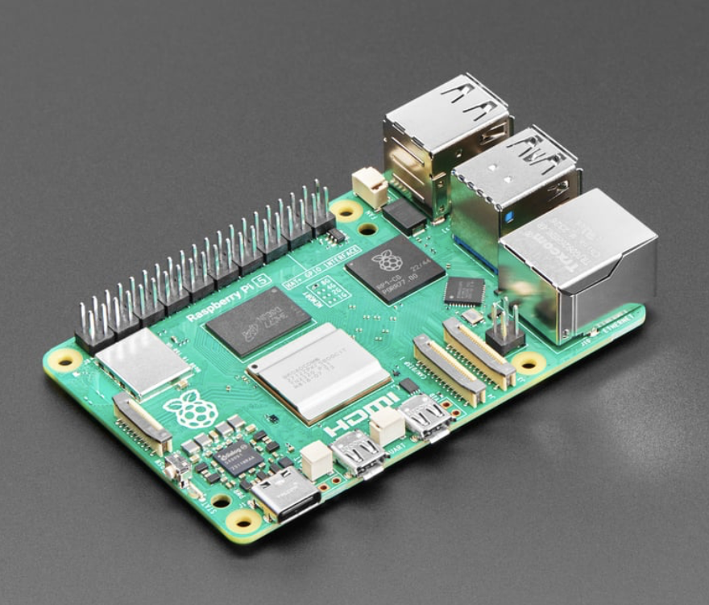
What is a Raspberry Pi?
The Raspberry Pi is a small, low-cost computer that fits in the palm of your hand.
It was developed by the Raspberry Pi Foundation to promote computer science education.
It can run Linux-based operating systems and connect to external devices through USB, HDMI, and GPIO ports.
Popular among students, educators, and hobbyists for DIY projects.
Example: Using Python on Raspberry Pi, you can control an LED light or even automate your room lighting.

Slide 3
History of Raspberry Pi
The first Raspberry Pi was released in 2012.
The idea was to make computing affordable and accessible.
It started with a basic model and evolved into more powerful versions.
Today, Raspberry Pi is used in everything from education to industry.
Key Milestones:
2012: Pi Model B launched
2015: Pi 2 and Pi Zero introduced
2019: Raspberry Pi 4 released

Slide 4
Raspberry Pi Models
Pi 1, 2, 3, 4: Each new model has more power, ports, and memory.
Pi Zero: Smaller, low-cost version for compact projects.
Pi 400: A Raspberry Pi built into a keyboard.
Pi Pico: A microcontroller for hardware-focused tasks.
Comparison: Pi 4 has up to 8GB RAM and dual-display support, whereas Pi Zero has 512MB RAM and no HDMI.

Slide 5
What can you do with a Raspberry Pi?
Home Automation: Control lights, temperature, and appliances.
Learning to Code: Practice Python, Scratch, Java.
Media Server: Stream videos using Plex or Kodi.
Web Hosting: Host a personal website or blog.
Gaming: Emulate classic video games (RetroPie).

Slide 6
Robotics and their movements
A robot can be defined as a programmable, self controlled device consisting of electronic, electrical or mechanical units.
Characteristics for Robots
  Sensing – The robot should be able to sense its surroundings and that is only possible with the help of sensors.
  Types of sensors - light sensors (eye), touch sensors (hands), hearing sensors (ears), or chemical sensors (nose).
  Movement – A robot needs to be able to move around its environment whether by rolling on wheels, walking, snaking or skating.
  Energy – A robot needs to be able to power itself which depends upon its power resources. E.g. - batteries, power generators or fuel.

Slide 7
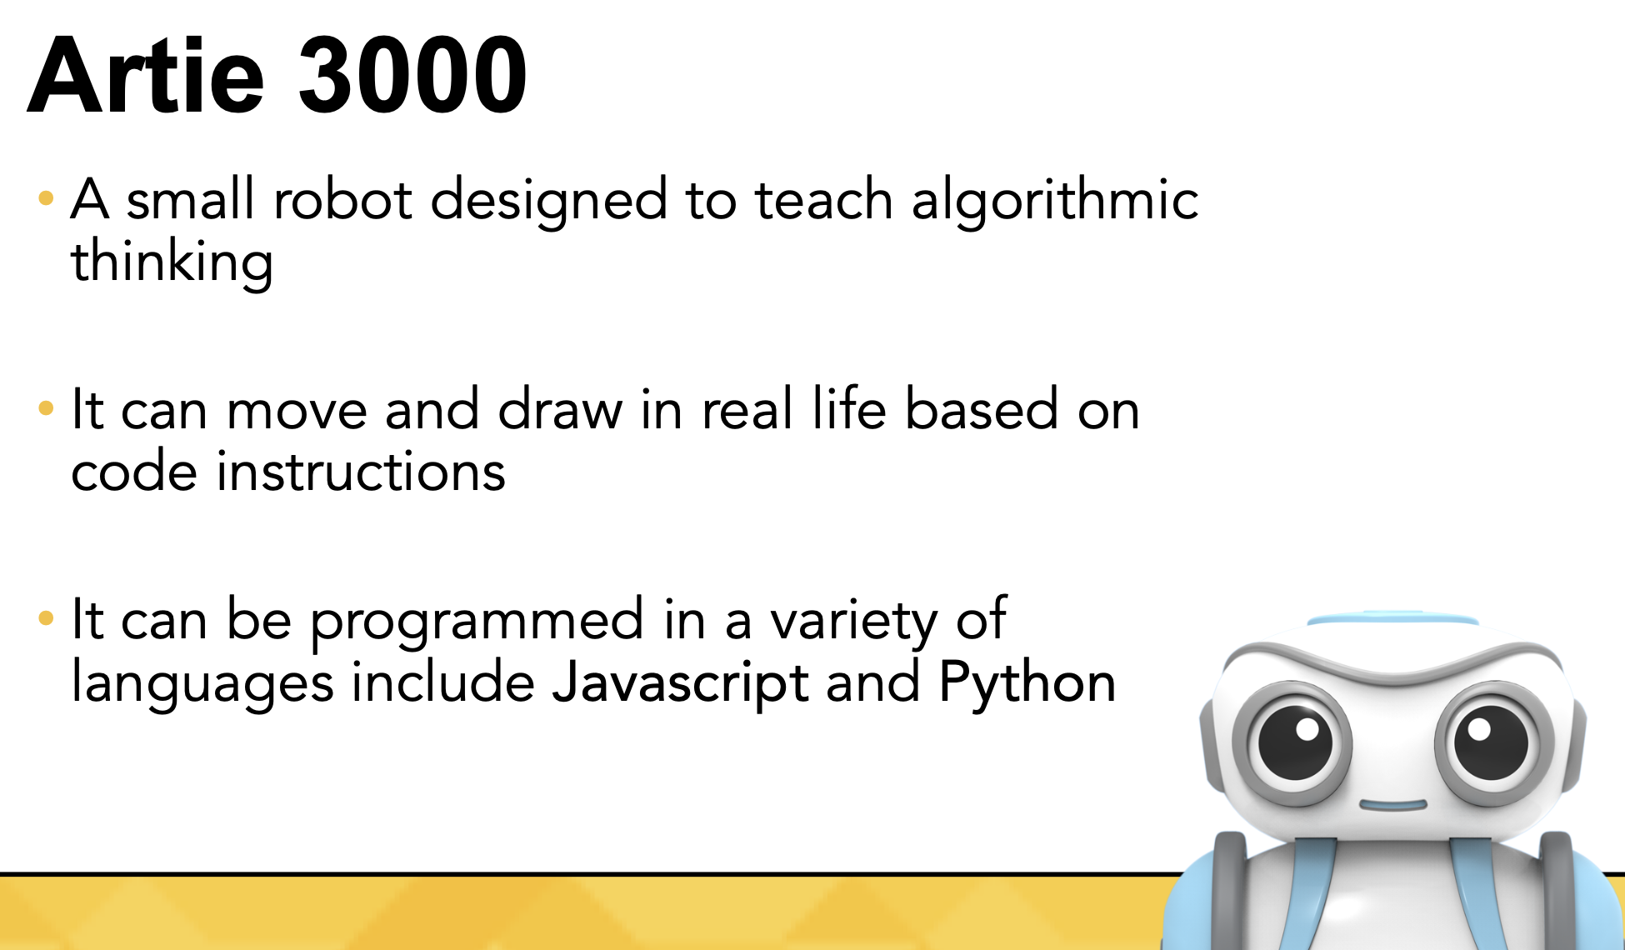

Slide 8
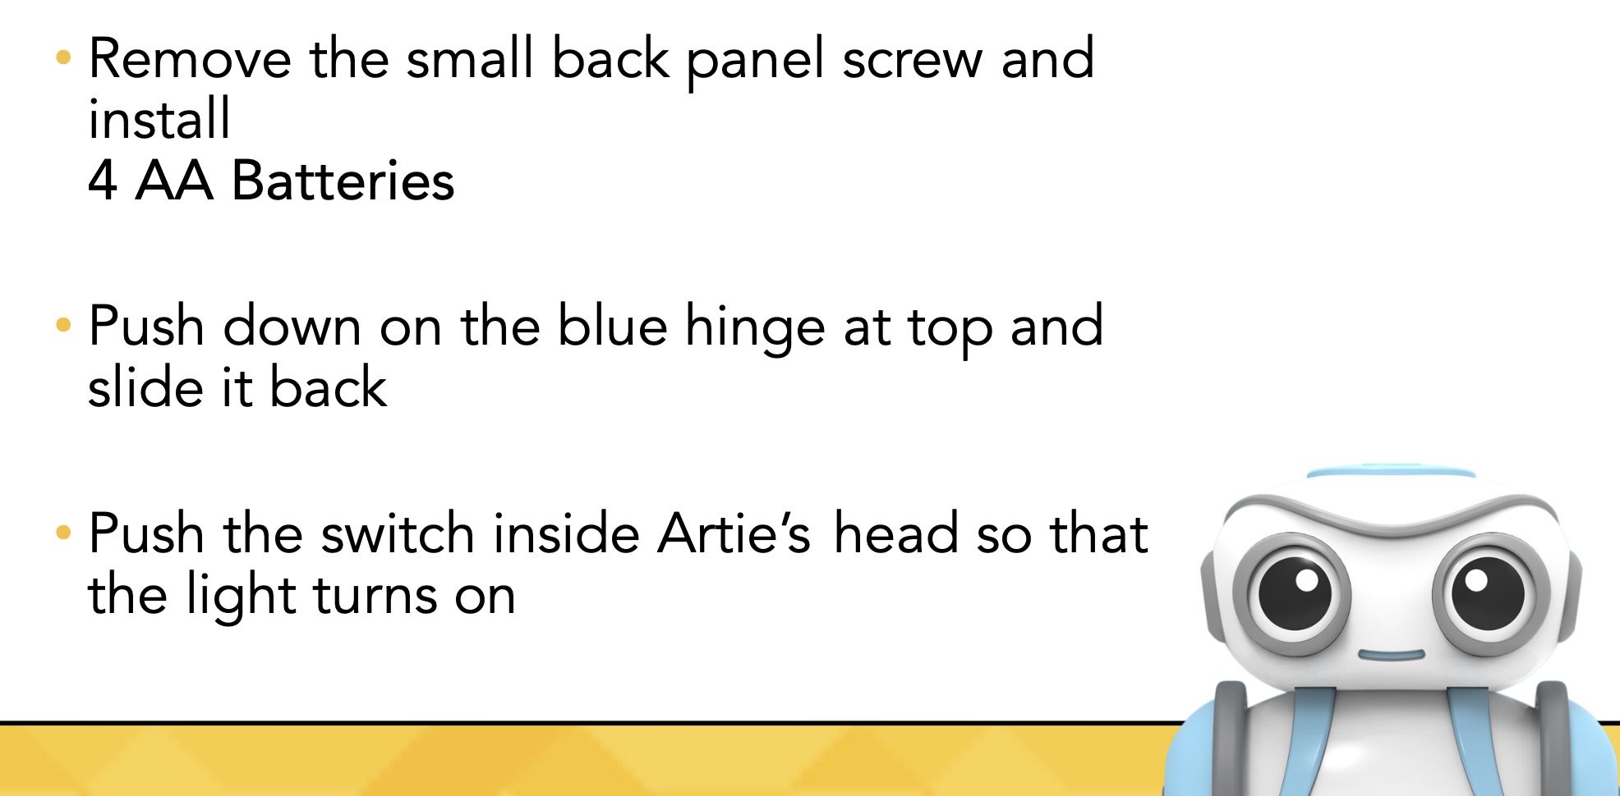
How to Set Up

Slide 9
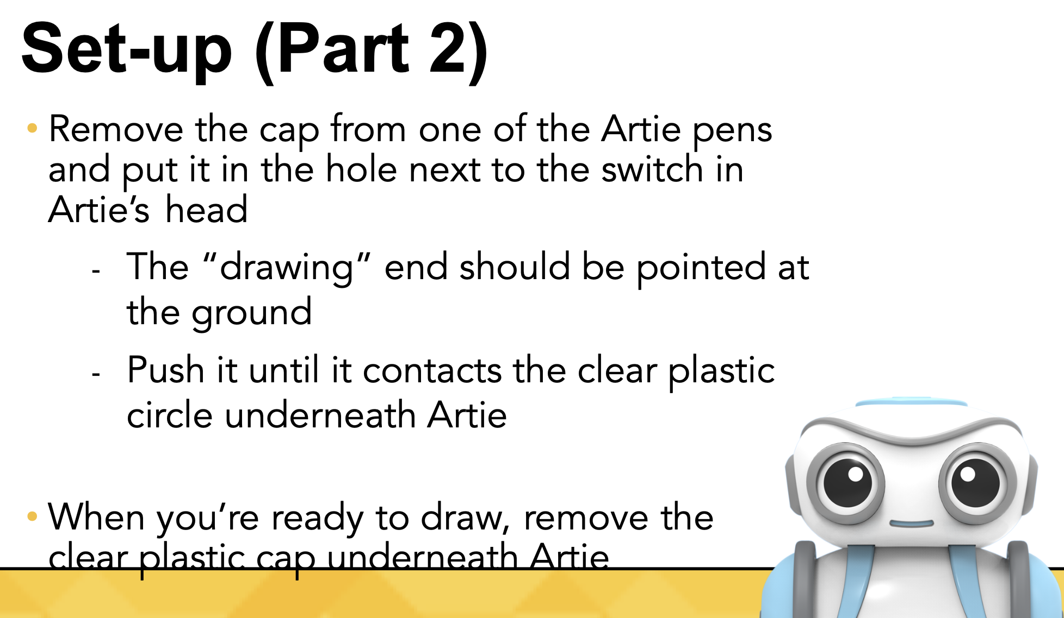

Slide 10
Set Up (Part-3)
Remove the clear plastic circle underneath Artie
Remove the cap from one of the Artie pens and put it in the hole next to the switch in Artie’s head
  The “drawing” end should be pointed at the ground
Put the clear plastic circle back underneath Artie
  This holds the pen in place

Slide 11
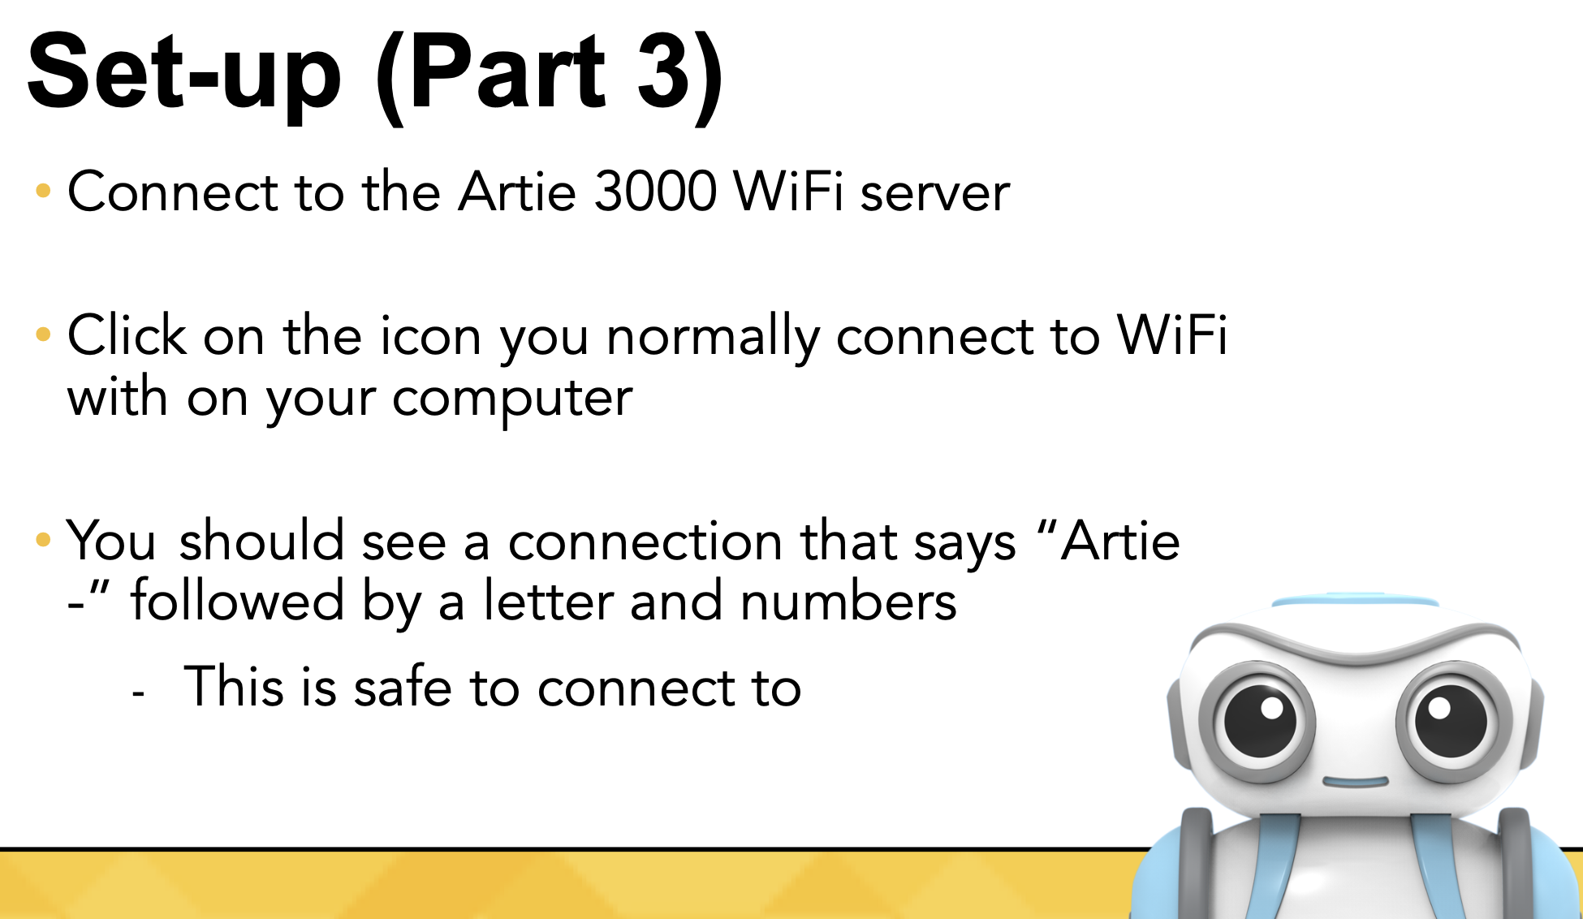

Slide 12
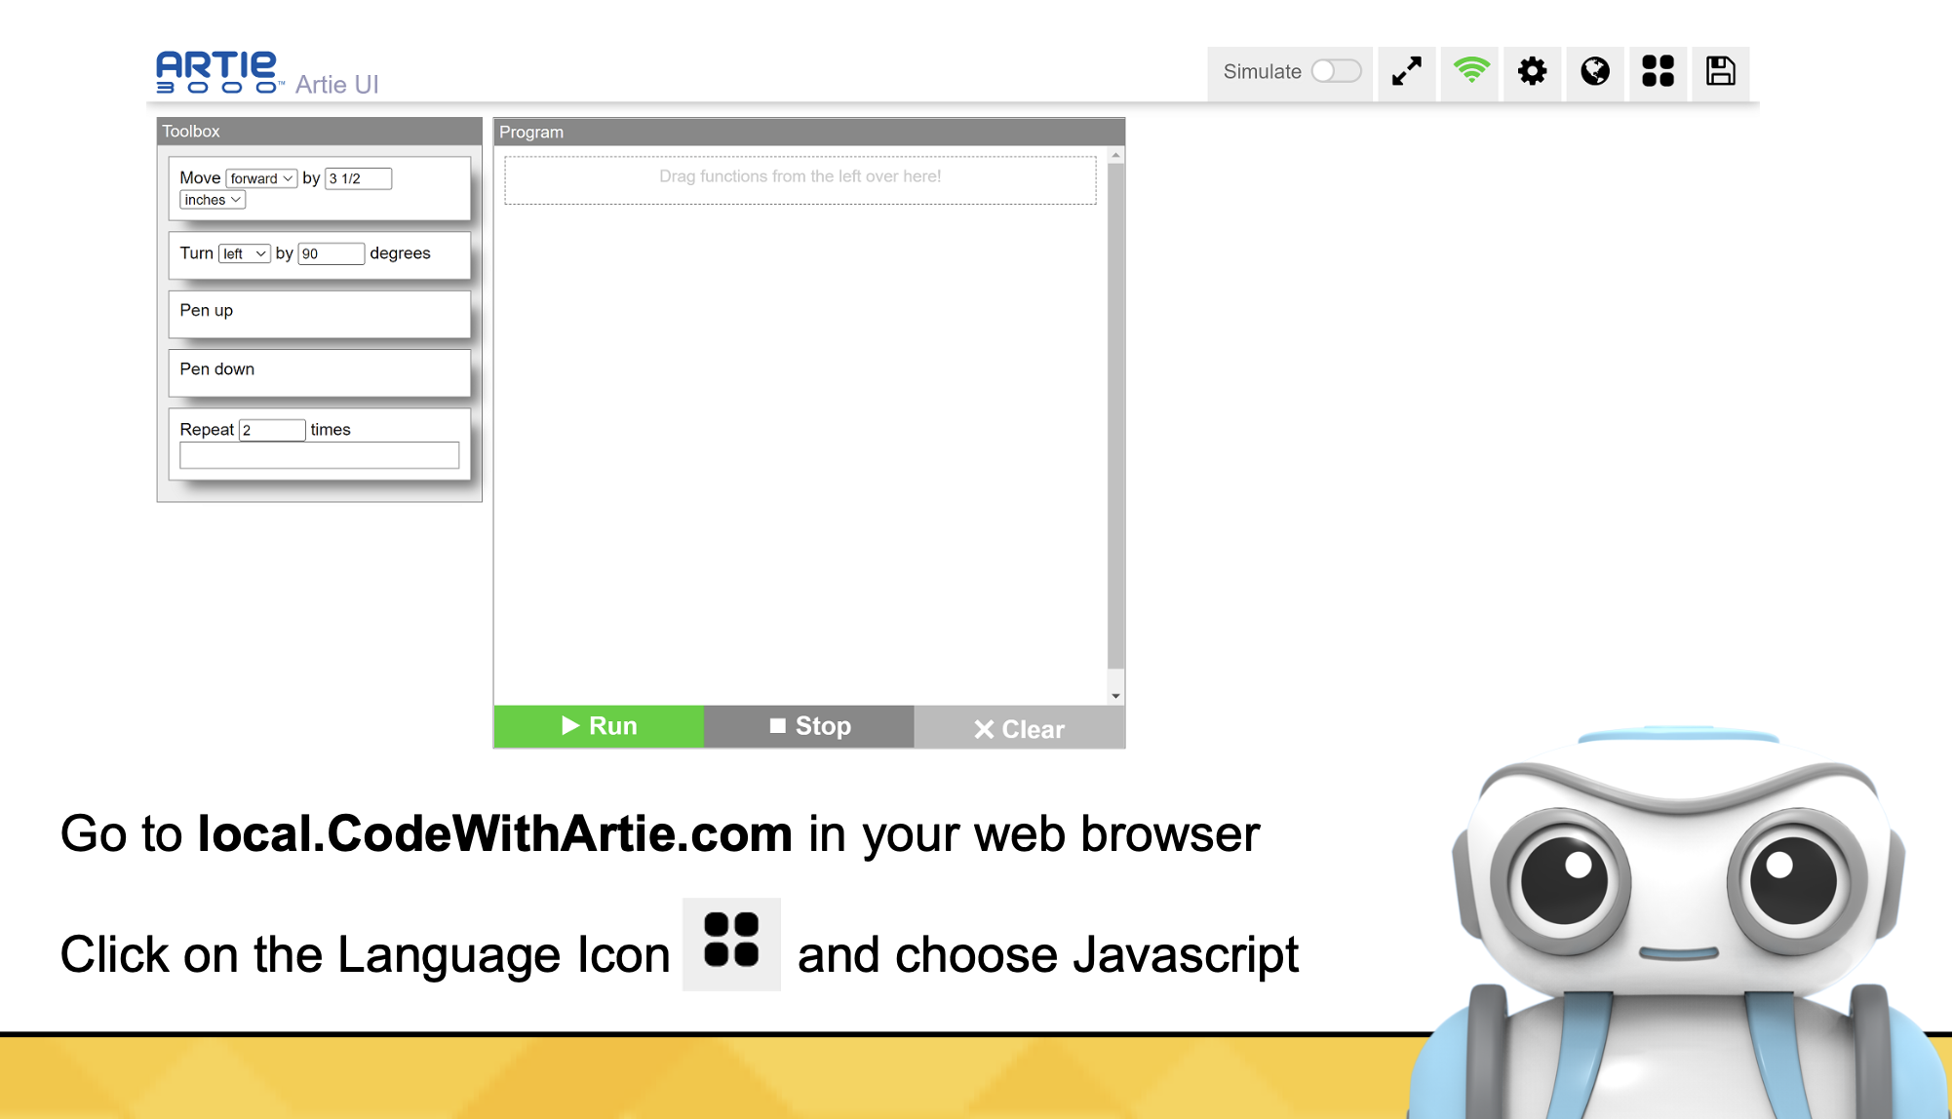

Slide 13
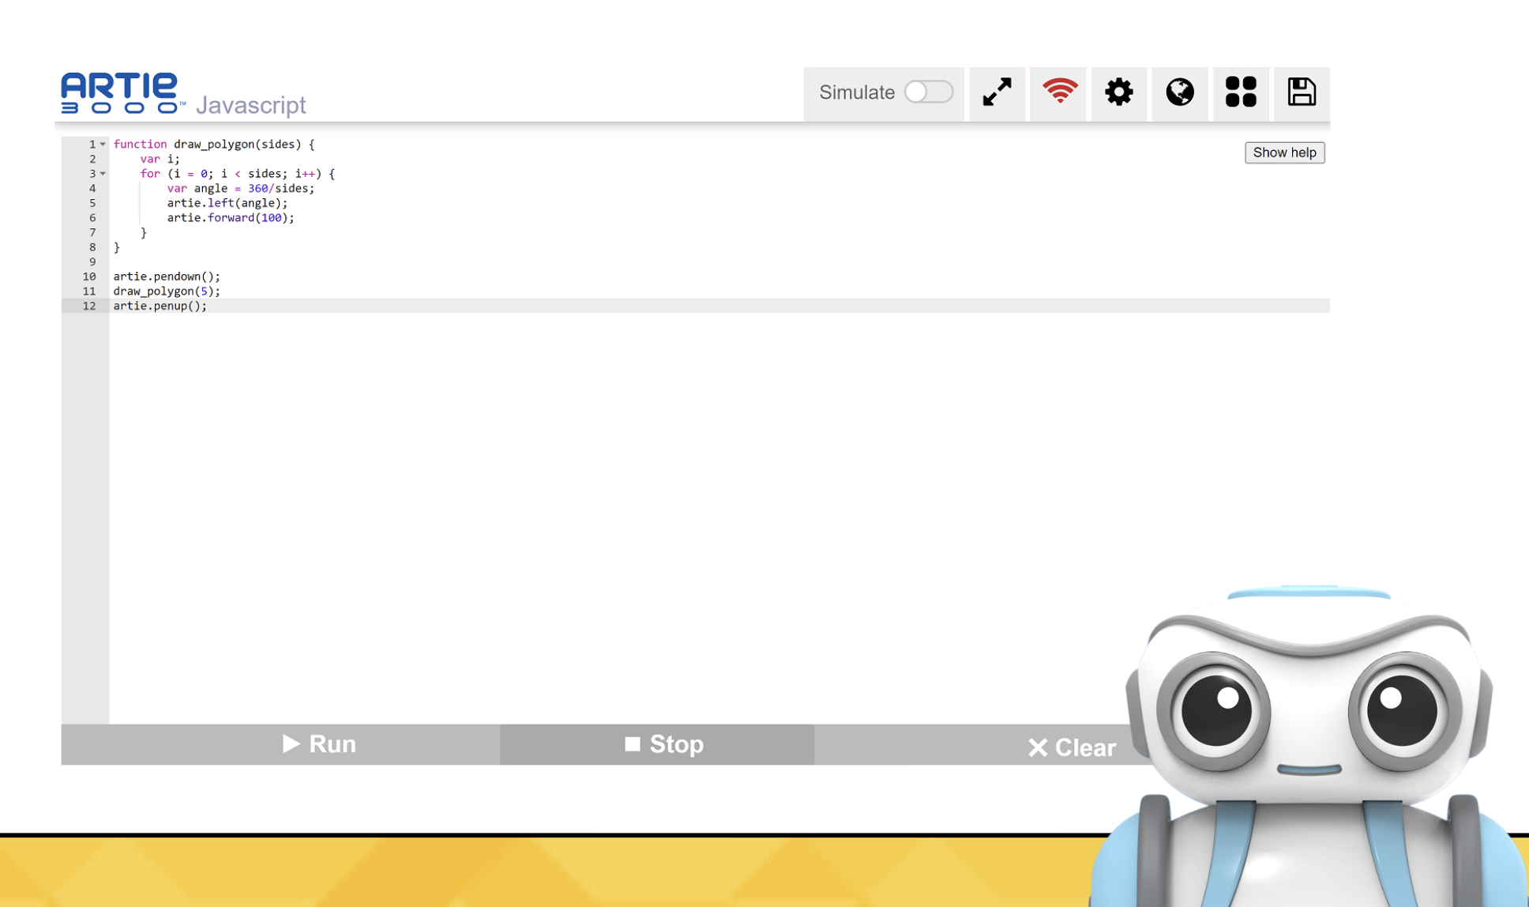

Slide 14
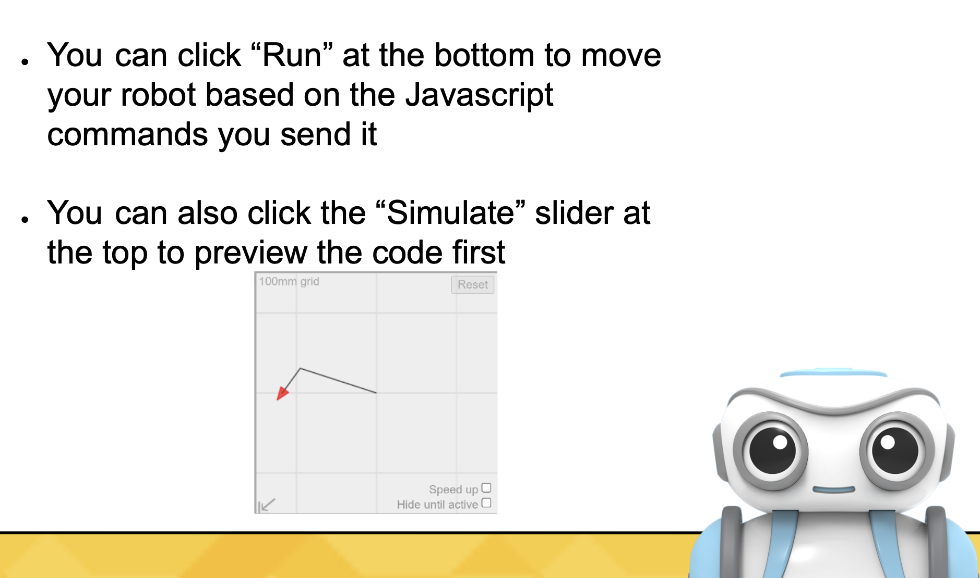

Slide 15
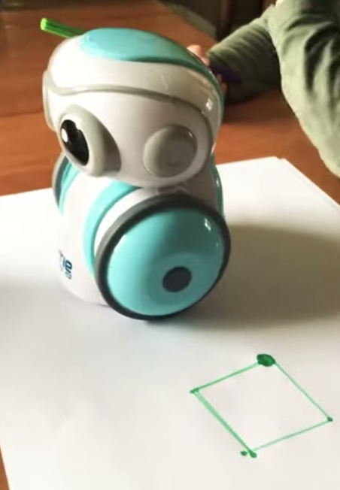
How to Code
To draw a SQUARE
Pen up
Move forward by 60 mm
Turn left by 90 degrees
Move forward by 60 mm
Turn right by 90 degrees
Pen down
Repeat 4 times
Turn right by 90 degrees
Move forward by 120 mm
Pen up
Now click “Run”

Slide 16
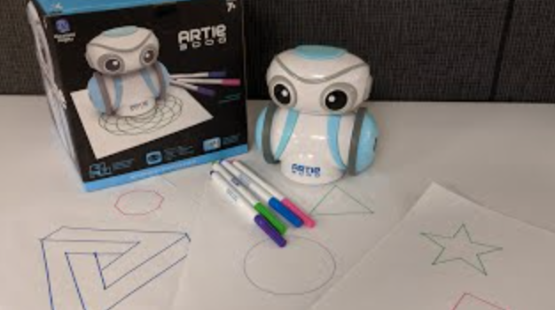
Now, try drawing a Circle, Triangle, Star and many more…

Slide 17
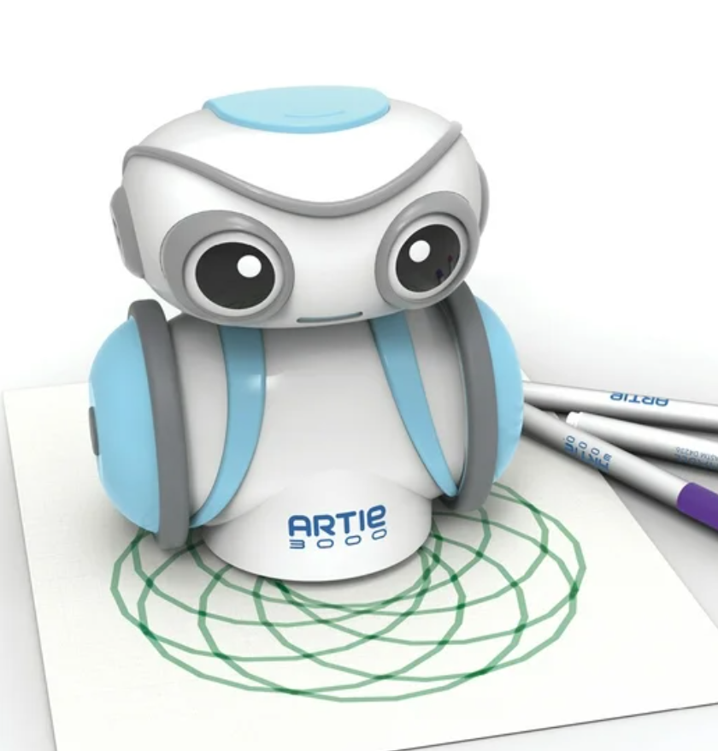
How to color using Artie 3000 (Mandala)
Pen down
Repeat 6 times
Turn left by 60 degrees
Repeat 36 times
Move forward by 6 mm
Turn left by 10 degrees
Pen up
Now click “Run”

Slide 18
How to create games using Artie 3000 (Hangman)
Pen up
Move back by 50 mm
Turn left by 90 degrees
Move forward by 70 mm
Pen down
Move back by 30 mm
Pen up
Move forward by 15 mm
Turn right by 90 degrees
Pen down
Move forward by 70 mm
Repeat 2 times
Turn right by 90 degrees
Move forward by 20 mm
Pen up
Move forward by 50 mm
Turn left by 90 degrees
Move forward by 12.5 mm
Repeat 5 times
Pen down
Move forward by 15 mm
Pen up
Move forward by 5 mm
Pen up
Now click “Run”

Slide 19
Uses and Advantages of Robots
Used in vehicles and car factories
Mounting circuits on electronic devices like mobile phones
Working where there might be danger like nuclear leaks and bomb disposal.
Surgeons are performing robotic surgeries.
Mail delivery to various mail stations throughout the building in large corporations.
Toy robots are a good source of entertaining for kids.
Robots do not get bored or tired and they can work 24/7 without getting paid or fed.

Slide 20
Disadvantages of Robots
It needs a high supply of power.
People can lose jobs in factories.
It needs maintenance to keep running efficiently.
Hight initial costs.
A robot cannot respond in time of danger as human can.

