Slide 1
CSE1101
Introduction to Artificial Intelligence (AI)
Notes:
Introduce yourself and welcome the students

Slide 2

Defining AI: What Is It, and What Is It Not?
A Broad Field: AI is a broad field of computer science.
The Goal: It's focused on building systems that can perform tasks typically requiring human intelligence.
  Key Capabilities: These tasks include learning, reasoning, and problem-solving.
What It's Not: AI isn't a sentient robot from a sci-fi movie.
The Reality: It is software designed to recognize patterns in data.
What is it great for:
  Automation
  Reduce human error
  Eliminate repetitive tasks
  Infinite availability
  Accelerated research and development

Slide 3
Example use cases for Artificial Intelligence
Speech recognition - Automatically convert spoken speech into written text.
Image recognition - Identify and categorize various aspects of an image.
Translation - Translate written or spoken words from one language into another.
Predictive modeling - Mine data to forecast specific outcomes with high degrees of granularity.
Data analytics - Find patterns and relationships in data for business intelligence.
Cybersecurity - Autonomously scan networks for cyber attacks and threat

Slide 4
Everyday examples of Artificial Intelligence
Many games you play utilize AI to play against you, or to operate the NPCs
Self driving cars
Pattern recognition
  Cameras being able to tell it’s a person, or package, or car
  Medical diagnosis
GPT (Generative Pre-trained Transformer) models are everywhere currently
  Help you write papers, slide presentations, compose emails etc
  Can generate images, video, sound
  Can write computer software.
  Can summarize web searches and present a short summary.

Slide 5
Current focus
Today the part of AI getting the most press is called GPT (Generative Pre-trained Transformer) or LLM (Large Language Models)
  These tools are newish, and allow you to “chat” with an AI in a natural way
  They are not the only use of AI
AI has been around a long time.
  Deep Blue beat the reigning world champion Garry Kasporov in May 1997.
  In Feb 2011 an AI called Watson won the tv show Jeopardy! beating champions Ken Jennings and Brad Rutter.
While the underlying idea is the same, the way they are trained, and how they are used varies wildly

Slide 6
Large Language Models (LLMs)
Advanced Prediction: Large Language Models (LLMs), like ChatGPT, are essentially advanced text predictors.
The Technology: They are built on underlying technology called the "Transformer."
  A transformer changes the input query to an output statement.
  It’s processing all the tokens in the sentence in parallel, and remembering the context between the words.

Slide 7
Training
All AIs need to be trained on example data.
Large Language Models (LLMs) are trained on a LOT of text.
  All books they can scan
  All internet text they can access
  All word docs/pdfs they can access
There are copyright issues we should talk about there, but we’ll get to that later.
Other models are trained on sound, images, videos, or human behavior.
  For example, self driving cars are trained by observing humans driving for millions of miles.
  Medical diagnosis tools are trained on millions of scans and what the Drs eventually diagnosed the patient with.

Slide 8
Artificial Intelligence Training Models
Supervised learning is a machine learning model that maps a specific input to an output using labeled training data (structured data). In simple terms, to train the algorithm to recognize pictures of cats, feed it pictures labeled as cats.
Unsupervised learning is a machine learning model that learns patterns based on unlabeled data (unstructured data). Unlike supervised learning, the end result is not known ahead of time. Rather, the algorithm learns from the data, categorizing it into groups based on attributes. For instance, unsupervised learning is good at pattern matching and descriptive modeling.
Reinforcement learning is a machine learning model that can be broadly described as “learn by doing.” An “agent” learns to perform a defined task by trial and error (a feedback loop) until its performance is within a desirable range. The agent receives positive reinforcement when it performs the task well and negative reinforcement when it performs poorly. An example of reinforcement learning would be teaching a robotic hand to pick up a ball.

Slide 9
Training is expensive
The internet is easy to get the text from, that’s what it’s designed for.
Physical books are harder, you have to scan each page. Sometimes that process destroys the book.
Once you have the data digitized, you have to understand what it is.
  This process is called labeling
  For example, you’ve probably received captcha challenges to prove you are human. You are being used to label objects for an AI
    “Choose all images with traffic lights”
  This part is critical, slow and expensive. It usually requires a human.

Slide 10
Training and tokenization
An AI prompt is broken down into tokens. These are typically short words of around 4 characters.
As the AI is being trained, it takes every word, and looks at how it relates it is to other words.
  Generally it’s trying to understand the relationships between words.
  Let’s imagine it is training on “The old man and the sea”
  It’ll create a token for “The”, “old”, “man” “and” “the” “sea”. Straight away it notices that “the” is in there twice.
  It’ll assign each “token” a number.
  It notices that “old” and “man” are next to each other, and seem to be related.
  Later when it sees “there was an old woman who lived in a shoe” it’ll realize that old can be put on front of man, or woman, or person, or folk.
It’ll create relationships like this:

Slide 11
Relationship Map
Old
Man
Woman
Young
Person

Slide 12
Map used to predict next word
Once you have read billions of lines of text. The map from the previous slide will contain most words in the language you are training on, and you’ll know which words are often related to each other.
  The more often you see a word pair, the stronger you make the relationship between those 2 words in the map
Now we ask the AI who is the president of KSU?
  It would look for words related to president
  It would look for words related to KSU
  The intersection of those 2 is possibly the right answer.
It’s actually doing this on all the words in the sentence simultaneously, this is a simplification of the process

Slide 13
Important thing to note
The AI doesn’t understand what any of the words “mean”. It just knows the word is related other words in the map.
  But it has no idea what a president is, or what KSU is.
This is critical to understand.
The output of LLMs looks magical, it looks like it understands you, but it really doesn’t.
This also explains why it may give you a very wrong answer. For example if all the training data is older than 2021, it may confidently answer “Pamela Whitten”. Or if it expands KSU to Kansas State University, it may return “Richard Linton”. It doesn’t really understand the difference.

Slide 14
Training bias
AI prediction is only as good as the data it’s trained on.
  If you were to train an AI on only your friends faces, imagine what it would think is the “average” face.
  Unless your friend group is representative of all nationalities, ethnicities, and sex, it would have an incomplete view of the world
  If it happened that all your friends happen to have large ears, then it’ll assume all people have large ears.
So how do you train it? You need a HUGE library, and furthermore that library needs to be representative and labeled reliably
  If you are facebook or google, you have access to millions of photos that users have uploaded.
  There are open source data sets such as laion.ai and commoncrawl.org which have labeled data.

Slide 15
Prompting an AI for an answer
To ask an AI a question, you submit a prompt
  “What is the capital of the United States?”
  It will first tokenize the question, and then begin searching the model for each of the tokens looking for related words.
    Capital is an interesting word. It can mean multiple things:
      Money and physical assets used to start or grow a company
      The city in a country where the government sits
      Uppercase letters
    The AI will see all those relationships initially.
  It will realize that United States refers to a country. Thus it’s now more likely we are dealing with the second meaning of capital.
After multiple rounds of processing it’ll likely get to the answer that Washington DC is the capital.
Note that it’s a probabilistic answer. If it gets the wrong context from the prompt, it’ll return the wrong answer.

Slide 16
Costs
Small volume users can use OpenAI, Gemini, Claude, Grok etc for free.
  There are limits on the number of tokens you can use per day or month.
If you wish to use AI beyond those limits you must pay.
  Most providers charge per 1 million tokens.
    Prices range by the newness and capacity of the model. They can be from $0.10 (Gemini 2.5 Flash-Lite) to $20 for gpt-6-astra long context.
    Audio, Image and video models can be more expensive. OpenAi currently charges $0.70 per second of 1080p video
These prices will likely increase since companies like openAI lost over $20billion in 2025.
  A lot of computers are needed with a lot of expensive GPUs and memory.
  These computers need data centers which are not cheap to build.

Slide 17
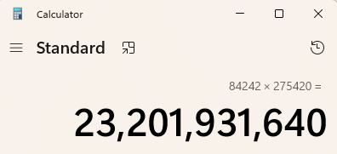
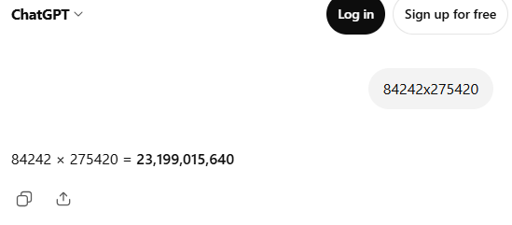
Issues with LLMs
As we’ve said multiple times, the LLM doesn’t actually understand what it’s giving you as an answer. It seems like it does, but in reality it’s just giving you probable answers
  This is likely what humans do also, and humans are often wrong with their answer too.
  The issue is that prior to LLMs we were taught that computers give you repeatable correct answers. For example, if you ask a calculator 84242x275420, you can likely believe the answer that you get back. If you ask an LLM that same question, you should have doubt about the answer.
  Notice how ChatGPT CONFIDENTLY tells me the wrong answer

Slide 18
Engage critical thinking
Thus while using an AI it’s very important to use it as a tool, but to continue engaging your critical thinking skills.
  Just because an AI said it, doesn’t mean it’s true, or accurate, or timely.
  Too many people are relying entirely on AI and treating it as if it’s always correct.
    It’s an awesome tool. It’s amazing at summarizing large texts, or producing an example of something you are having a hard time finding otherwise.
    But you should always treat it as an opinion among others.
  I had to validate which of the answers were correct. It’s a good thing I remember how to do long multiplication by hand. This is an important lesson when using AIs, understanding what it's outputting allows you to validate answer.
The internet is full of stories of people getting rich/famous with AI
  “I used AI for all my investments and made $2million in 3 months”
  “The one shortcut professors don’t want you to know…”
Ask yourself if it makes sense before you believe it.

Slide 19
Generative Adversarial Networks (GAN)
One idea is to have multiple AIs approach the same problem from opposite sides. The hope is the end result is a better result than either could make alone.
For example, one AI creates fake images. The other AI tries to identify fake images, and reports what looks fake.
  The 2 can go around in a circle for a while, until they agree on an image which is as close to realistic as possible.

Slide 20
Types of Artificial Intelligence
There are 3 levels of AI:
Artificial Narrow intelligence (ANI): This is the only type of AI we have today. Each AI is trained to perform a single task.
Artificial General Intelligence (AGI): This is a theoretical level where an AI could match human intelligence and learn independently across multiple domains. This does not exist today.
Artificial Superintelligence (ASI): A theoretical super AI would be able to think, reason, learn, and make judgements in a way that is superior to humans. Again, this does not exist.

Slide 21
Ethics of AI
Any discussion of AI is incomplete without a discussion about its impact on society.
  Data Centers - AI requires huge amounts of infrastructure.
    At the moment the cost of Ram, Hard Drives and GPUs are very elevated due to AI companies buying up all the production of these items. This raises costs for average families.
  Job losses - AI is replacing jobs that people once held.
    Autonomous Vehicles are replacing Uber, Lift, and Truck drivers. Millions of people are currently employed as delivery people, taxi drivers, truck drivers.
    AI is replacing administrative assistance, front desk people, software developers, legal researchers, and many other roles.
    Many other industries are starting to see AI replace workers
  Copyright/Creative issues. All that training data came from somewhere.
    Artwork that was created by humans trained AI, which can now produce similar styled artwork for free.
      If that causes people to stop practicing art, does art stop evolving?

Slide 22
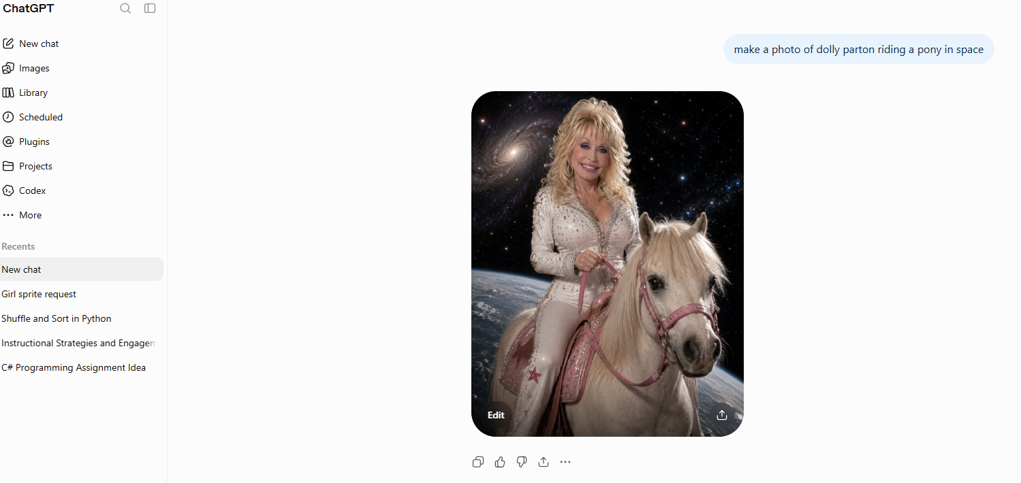
Eroding Truth
A few years ago, if you wanted to fake an image of someone riding a pony in space you’d have to find an image of the person, an image of space, and an image of a pony and try to use photoshop or similar to edit them together.
  It was time consuming, and relatively obvious to spot unless you had really good photoshop skills
  Now basically anyone can do it in seconds:

Slide 23
Critical Thinking
How can you tell that photo is AI generated?
  OK, well there is the obvious problems:
    You can’t breath in space, so they’d be dead, not smiling
    There is no gravity in space, so what’s holding her on the donkey?
    Where is the source of light in the image. There is a reflection on the left side of her face, and knee. But look at the donkey, the light on it comes from the other side. She’s lit from one side, the donkey from the other…not really possible.
    There are probably many other problems.
However, at a quick look, it’s believable. Better than I could do in photoshop without a lot of time.
The problem this is causing society is that it’s now much harder to know what to believe.
  When you wrote a paper in middle school, you had to cite your sources…today, it’s hard to know the veracity of any source.
This is only going to get worse. We are only starting to see the effects of this on society.

Slide 24
Is using AI in college bad?
You are paying to learn skills that employers need to hire you. Be sure you are actually learning those skills.
  If all you are doing is pasting answers from AIs, everyone can do that, so you’ll have a hard time finding an employer to hire you.
  This degree cost money, be sure you are learning to get value for money.
It can be a great resource if used correctly
  Ask AI to summarize a topic you are having a hard time with. Reading the summary may be a good start
  Ask AI to create a practice test based on a set of slides.
  Do the work yourself. Ask AI to generate an answer, and see if you got it right before you submit your own work (note: don’t submit the AI’s work)
    Warning: Remember AI isn’t always right.
As long as you are learning it’s another tool that can be used.

