Slide 1
Computational Thinking

Slide 2
Beginning to think like a computer
Computers seem to do magic.
  One minute they are writing your term paper
  The next you are using it to play a game
  Later you are watching a movie on it.
How do they do all these things?
  The answer is software!
The first step in understanding software is understanding how to think like a computer.

Slide 3
What is software?
A computer program is referred to as software.
Computer software is written in a specific programming language (e.g. Java, C#, C++, Python etc)
They are implementing a particular algorithm that a human designed.
Every single application, program and website you’ve ever used was designed as an algorithm, and then coded in a specific language

Slide 4
Easy vs Hard
Writing code is different but not difficult once you practice.
  Most programming languages are similar, once you know one, you can adapt to another.
  Computer languages are very specific, they require you to code in a specific way. Once you understand the syntax of the language, coding is actually easy.
The hard part is coming up with the algorithm. Or to phrase it differently, the hard part is problem solving. This takes a lot of practice and will be frustrating at times.

Slide 5
Decomposition - Breaking down a problem
The first step to computational thinking is to take a big problem, and break it down into smaller problems that are more manageable. This is called decomposition.
While you are doing this step, ignore unnecessary details. Don’t get focused on a small detail, you can deal with it later.

Slide 6
Throwing a party
You need to figure out the following things:
  Where to host it
  Who you are inviting
  What entertainment you’ll have
  What food/drink you’ll offer
This is the first step, breaking it down into high level categories.
  Now you can address each of these categories
  You could also assign each category to one person to distribute the work.

Slide 7
Pattern Recognition
Often when solving parts of the problem you’ll realize you have previously solved a similar problem.
  This is more likely to happen when you have smaller problems.
  The smaller the problem, the more likely you’ve done it before, or you’ve done something very similar.
  Pattern recognition is where you realize one problem is similar enough to another that you can solve it even though you may never have seen it before.
For example, with picking food for the party, you might realize it’s similar to picking food when you have a friend over.

Slide 8
Let’s take an example
On the next slide is a section of the new york subway map.
Assuming you are currently in wall street, how do you get to Rockefeller Center?
While you are figuring out the answer, think about HOW you are solving this?

Slide 9
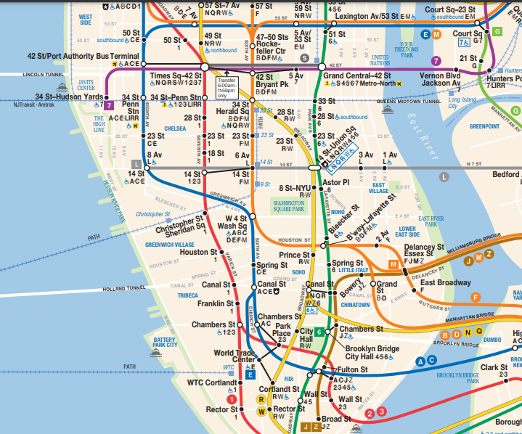
Rockefeller Center
Wall Street

Slide 10
Steps
Notice what line Wall St is on (Red, 2 3)
Notice what line Rockefeller Center is on (Orange BDFM)
Since these are different lines you’ll have to find a place where they overlap
  This doesn’t turn out to be simple, there is no direct overlap, so you’ll have to find an intermediate line
You could take Red 2-3 to Time Square, then transfer to 42st Bryant park, transfer to Orange go to Rockefeller Center.

Slide 11
Solution!
OK, so we have a solution. Now is it a good one?
How to measure “goodness”?
  Does it get us there? yes
  Does it get us there efficiently enough? maybe
  There may be other criteria, some people may know that one line is more crowded than another and may want to avoid it at certain times etc. On some days individual lines may not be running

Slide 12
Efficiency
For now, this isn’t your primary concern, however, there are obviously terrible answers to this problem
  Step 1, Take Blue A C to JFK airport, fly to Sydney Australia, Step 2, fly back to LaGuardia take purple 7 to Grand Central walk a block.
But a valid question is if the transfer is worthwhile? The red line never gets you to Rockefeller center, but it does stop at 50th st, which is 3 blocks from Rockefeller center. So would you be faster to just walk the 3 blocks?
  This is something you’d have to try to figure out the right answer to. Or ask a local.

Slide 13
Finding the solution
For most problems there will be many possible solutions. Don’t worry too much about finding the “right” one. For now, just focus on find a working solution.
Notice there are many many lines and stations on the map that we never looked at. This is ignoring irrelevant data. A critical step in problem solving, focus only on what you need to solve the problem

Slide 14
Algorithm to navigate subways
Figure out what station you are at, and which line it’s on.
Figure out where you want to go
  Which station is closest to your destination
  What line is that station on
If the line is the same, go!
If not, find a connecting point between the two, or a 3rd line that connects them.
  You may need to find a 4th or 5th line to connect them…but probably not.
Go, transfer at each connecting point, you’ll get to your destination.

Slide 15
General steps to solve this problem
If I now gave you a map of the London Tube, could you apply the same algorithm that you just came up
Yes!
  Because we’ve written general steps that say nothing about New York, this algorithm will work on any subway/tube/underground system in the world.
You’ve written your first algorithm!

Slide 16
Why not just use Google/Apple Maps?
You may realize you can also just ask your phone’s mapping app to get you there. Tell it you are on transit and it’ll generally tell you which train/bus to get on and off.
  This is awesome, and it’ll get you there.
    What do you do when your phone’s battery is dead?
    What happens if you are in a new city with no cell service?
    What happens if you drop your phone and the screen smashes?
It’s good to have the basic skills, so you can do it yourself when needed.
I’ll let you draw the parallels between this example, and using ChatGPT for everything.

Slide 17
Let’s define some terms we’ve used
Algorithm - A set of sequential steps to solve a problem
  They should be:
    Specific
    Sequential Steps
    Simple
    Solve the problem
  Algorithms contain Data and Instructions.
    Instructions might be “Get on the 2 train uptown, get off at 50th street
    Data might be the time of day you are doing this ride, because some trains only operate at certain times. So the algorithm has some INPUT which likely includes (source, destination, time of day, day of week).
  Algorithms typically have input, output, and processing
  Should anticipate things that can go wrong

Slide 18
Let’s define some more terms we’ve used
Abstraction - Taking a big problem, breaking it into smaller problems, identify patterns, group like things together, build back up to an overall solution, while ignoring unnecessary detail
  The NY subway map is an abstraction, they don’t show every building along the way, they focus just on the subway lines and stations. Because that is all that is necessary to find your way on the subway.
    Likewise we further abstracted by ignoring the lines which were not relevant to our search
Abstraction is about making problems easier to think about by representing essential features without background detail or explanation
We do this in everyday life.
  How did you get here today? Give me details?

Slide 19
Let’s define some more terms we’ve used
Software - A computer program that solves a particular problem.
  It is the implementation of a particular algorithm in a particular programing language.
Programmers/Developers/Coders are people who solve problems by writing algorithms and then converting them to a particular language. They are problem solvers.

Slide 20
Finally Computational thinking…
Computational thinking or algorithmic thinking is to think logically about problems.
To take a big overwhelming problem, break it down, and start to solve parts of it.
You cannot just memorize this skill, it’s something you have to practice over and over.
  It is however an excellent life skill once you understand it.
  It will hurt a little along the way, you’ll often feel like you are never going to understand it, that’s normal, come and ask questions until you do!

Slide 21
Typical Software Development cycle
Define the problem clearly so everyone understands the same problem we are solving (requirement gathering)
Plan the solution (ie, write the algorithm that will solve the problem)
Code it (ie, convert the algorithm to a programing language)
Test it (ensure it actually does what you agreed to)
Document

Slide 22
Ways to express an algorithm
English - Write a concise set of steps to solve the problem
Flow Charts - Draw a diagram that shows the decision points
Programming language - Written in the specific syntax of a language
  More about this much later.

Slide 23
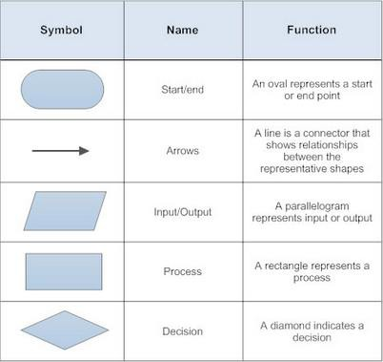
Flowchart Symbols
We use special shapes to represent different types of actions or steps in a process.
Lines and arrows show the order (SEQUENCE) of the steps, and the relationships among them.
The type of diagram determines which symbols are used.

Slide 24
Example Flow Chart
Passed CSE1101?
Yes
Start
Congrats, you are done
No
Study More

Slide 25
Let’s look at our first bit of computer code
We are going to do some work with turtle graphics. Let’s get setup so we are ready to go.
We are going to use a website which allows us to write some code and see the output:
  https://pythonsandbox.com/turtle

Slide 26
Steps to get started
Once you open the website you’ll see some code on the left side and a blank window on the right.
On the left it says:
  import turtle
  t=turtle.Turtle()
  t.speed(5)
  t.forward(100)
If you click the play button at the bottom, it’ll draw a straight line.

Slide 27
Turtle Graphics
The idea is that you are moving a “turtle”.
  This turtle looks like a little triangle.
  The turtle carries a pen, and allows you to draw.
  The turtle will do exactly what you tell it to.
You can tell it to move
  forward,
  backwards,
  turn left,
  turn right,
  Lift the pen (Stop drawing)
  Lower the pen (Start drawing)

Slide 28
Example
To draw a square you would go forward, turn left 90 degrees, go forward, turn left 90 degrees, go forward, turn left 90 degrees, go forward:
import turtle
t = turtle.Turtle()
t.speed(5) # 1:slowest, 3:slow, 5:normal, 10:fast, 0:fastest
t.forward(100)
t.left(90)
t.forward(100)
t.left(90)
t.forward(100)
t.left(90)
t.forward(100)

Slide 29
Experiments
The size of the square is determined by the t.forward(100).
  What would happen if you did t.forward(20) each time?
  How about if the first forward was 20, the second was 100, the third was 20, and the last one was 100 again?
What would happen if you changed the t.left(90) to t.left(45)?
What would happen if you changed the t.left(90) to t.right(90)?

Slide 30
Task
Figure out how to draw a 50 pixel square in the top left corner of the screen
  Utilize your new computational thinking skills
    Figure out where the top left corner of the screen is.
      This will take some experimentation
    You probably want to get there with the pen up so you don’t leave a line behind.
    Then draw a square just like you did with the rectangle on the previous screen

Slide 31
Don’t just look at the answer
You won’t learn anything by just reading the answer.
  You don’t become good at playing a video game by watching others play it, you have to actually play it yourself.
  This is true for all things in life. You have to take the risk and try it yourself, often failing, to be able to succeed.
We provide the answer so you can check your work
  Remember there are often many different ways to do the same thing. Just because we provided one way doesn’t mean it's better than any other way that achieves the same outcome.

Slide 32
Solution
import turtle
t = turtle.Turtle()
t.speed(5)
#First get into place
t.left(90)
t.penup()
t.forward(280)
t.left(90)
t.forward(250)
t.left(90)
t.pendown()
t.forward(50)
t.left(90)
t.forward(50)
t.left(90)
t.forward(50)
t.left(90)
t.forward(50)

Slide 33
A few more things
Anywhere you see a # symbol, anything after that is a comment
  Comments are ignored by the computer, they are just there for humans
  You can have as many comments are you like, they are helpful to understand complex code.
At the start of the code you see:
import turtle
t = turtle.Turtle()
These have to be here, they are used by python to know you are using the turtle graphics library. Don’t worry about the details of them for now. Just include them always at the top of your code.

Slide 34
Challenge
Take what you learned in the last example, and see if you can draw a pentagon.
  A pentagon has 5 sides instead of the 4 you drew for a square.
  You might have to try different angles until it looks right.

Slide 35
Pentagon Solution
import turtle
t = turtle.Turtle()
t.forward(100)
t.left(72)
t.forward(100)
t.left(72)
t.forward(100)
t.left(72)
t.forward(100)
t.left(72)
t.forward(100)

Slide 36




Try to draw the following shapes:
A triangle pointing down
A triangle pointing up
An equals sign
A not equals sign

Slide 37
Downward Triangle
import turtle
t = turtle.Turtle()
t.forward(50)
t.right(120)
t.forward(50)
t.right(120)
t.forward(50)

Slide 38
Upward Triangle
import turtle
t = turtle.Turtle()
t.forward(50)
t.left(120)
t.forward(50)
t.left(120)
t.forward(50)

Slide 39
Equals Sign
t = turtle.Turtle()
t.forward(50)
t.right(90)
t.penup()
t.forward(25)
t.right(90)
t.pendown()
t.forward(50)

Slide 40
Not equals sign
import turtle
t = turtle.Turtle()
t.forward(50)
t.right(90)
t.penup()
t.forward(25)
t.right(90)
t.pendown()
t.forward(50)
t.penup()
t.left(90)
t.forward(10)
t.left(135)
t.pendown()
t.forward(70)

Slide 41
Lines…circles?
How do we draw a circle?
Effectively you draw a dot, move left or right 1 degree, draw another dot, and do that again and again until you’ve reached 360 degrees.
That will be a lot of lines:
  t.forward(1)
  t.right(1)
  t.forward(1)
  t.right(1)
Surely there is a better way?

Slide 42
Repetition
What we just described is repetition, do the same thing over and over.
  This is a skill computers are very good at.
  We’ll use a loop called while.
    It’s something we’ll talk more about later, but for now just go with it.

Slide 43
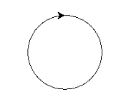
A Circle
import turtle
t = turtle.Turtle()
i=1
while i<360:
t.forward(1)
t.right(1)
i=i+1

Slide 44
A few things are happening here, let’s break it down
i=1
  This sets up a “variable” called i. Think of it like a storage place that can hold a number. Right now it’s holding the number 1
while i<360:
  This tells the program we want to keep repeating the loop as long as i is less than 360.
t.forward(1)
  This we’ve seen before, move the turtle forward 1 space. Note there is a TAB at the beginning of this line, without the tab you’ll get an error. This is a weird syntax rule of python, don’t worry about the details, just remember to put the tab in or it won’t work.
t.right(1)
  Same here, must be a tab at the beginning of this line.
i=i+1
  Remember that “variable” we created at the top of this slide, now we are asking it to increase the value of that variable by 1. So if it’s currently 1, when this statement executes it’ll be 2, if it’s currently 2, this will make it 3 etc. Eventually it’ll get to 360 and the while loop will stop

Slide 45

Your turn
Draw a semi circle
Note this is a bit tricky…the turtle points to the right when you start, but you probably want him to point down to start with, otherwise you’ll get a sideways semicircle.

Slide 46
Steps to solving more complex shapes
Use abstraction, focus on the task, brush away unnecessary detail, try to solve the most basic part you can.
Solve that part, and then experiment to figure out the more complex parts.
  Fun fact, when coming up with these slides, the solution for not equals was the 10th algorithm I tried, it took a moment to figure out where the crossing line should start and end.
  That’s normal, don’t give up!
Keep trying until you get it.

Slide 47
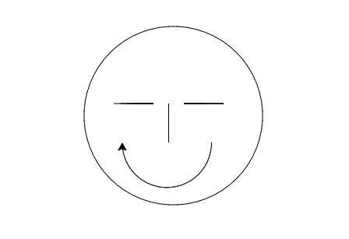
Make a smiley face
Smiley faces are made up of:
  The face (a circle)
  2 eyes (we’ll just do lines)
  A nose (we’ll just do a line)
  A smile (a semi circle)

Slide 48
Solution
t.penup()
t.left(180)
t.forward(100)
t.left(90)
t.left(90)
t.forward(100)
#Head
t.pendown()
i=0
while i<60:
t.forward(12)
t.left(6)
i=i+1
#Nose
t.left(90)
t.penup()
t.forward(80)
t.pendown()
t.forward(50)
#Eyes
t.penup()
t.left(90)
t.forward(20)
t.pendown()
t.forward(50)
t.penup()
t.left(180)
t.forward(90)
t.pendown()
t.forward(50)
t.right(180)
t.forward(15)
t.right(180)
#Smiley
t.right(90)
t.penup()
t.forward(50)
t.pendown()
i=0
while i<180:
t.forward(1)
t.right(1)
i=i+1

Slide 49
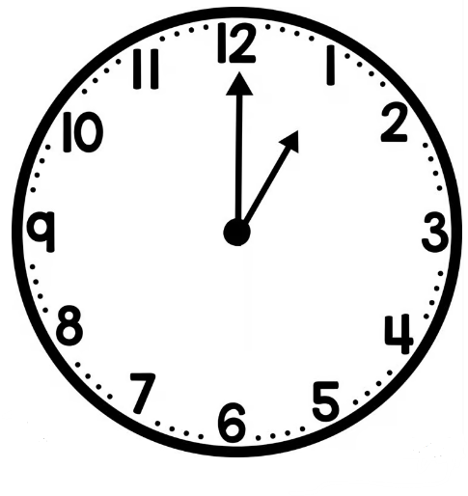
Want a real challenge?
How would you draw an analog clock face?
  You don’t actually have to do it, but how would you?
  Break it down into smaller parts
  Draw the circle
  Draw each number
  Draw the hands
Suddenly each part doesn’t seem that bad, and now you know you could do it.

Slide 50
Summary
Problem solving is a very important life skill.
  Not only for this class and other computing classes, but for your other classes, your career and personal life too.
  The key is to keep trying. You’ll get there unless you give up.
  There is no magic, trying takes time. Shortcuts mean you didn’t learn anything, just stick with it, and keep trying!

