Slide 1
CSE1101
Operating Systems

Slide 2
Early computers
In the beginning only large universities and government agencies could afford computers.
The first computers could only handle one program at a time.
  Programmers wrote their programs on punch cards.
  Once the computer was available, the punch cards were fed into the machine.
  The machine printed out the result (often on paper).
  Running a program often took a lot of time.
    If there was a problem with the program, the programmer had to wait for another turn.
  Often printing the result took longer than the computer took to calculate the result.
    Printers are slow.

Slide 3
Waiting…waiting…waiting…
As computers became more capable, their processing power soon exceeded the speed which we could feed punch cards in and get results out of the printer.
The first idea for an operating system was “batch processing”. Instead of the computer having to wait for an operator to feed in the next program, why not have the computer automatically move from one program to the next.
  You load the cards for multiple programs into the feeder, and you give the computer a way to know when a specific card is the last or first card or a program.
  The program which managed the “jobs” or programs was called an operating system, as it helped the computer to operate.

Slide 4
Wasted Resources
The punch cards were loaded in via a device. The printer is another device. These are examples of peripherals.
In general peripherals are very slow.
  A modern printer may take a second to print a page. But a computer can process about 3 billion operations per second. Thus, a computer can process thousands of pages of text in the time it takes the printer to print one.
  Old printers (dot matrix) were even slower.
While the peripherals were working, the computer itself was bored, wasting resources.
The next idea was to allow the computer to start working on the next program while it waited on the peripherals.

Slide 5
Multiprocessing
Imagine you are a computer and you have 3 “jobs” or programs you need to accomplish.
  Print out a three-page homework assignment
  Recalculate a spreadsheet with thousands of formulas
  Ask a user for 7 guesses in a word game
A critical realization is that the user will not give you the 7 guesses in 7/3000000000th of a second. Most likely it’ll take the user multiple minutes
You should:
  Send the print job to the printer, and it’ll take it however long it takes.
  While it’s printing, ask the user for the first guess.
  Once you have that, start working on the spreadsheet.
  Check back on the user every now and again
  Keep working on the spreadsheet
  Finally check on the printer

Slide 6
How to multitask
You’ll need a list of tasks.
You’ll need to know which task is ready to go, and which are waiting on something
  Could be a peripheral or the user, or something else (such as an internet request)
You’ll need to be able to know where you left off in each task.
  For example, in the spreadsheet, which formulas have you already calculated.
There are many considerations here:
  Be careful to not spend all your time on one task while other possibly more important tasks wait.
  Each time you switch tasks it takes some time to remember where you were.
  A balancing act is necessary, this turns out to be hard

Slide 7
You do this in life
You may have homework to do in multiple classes
You may need to take a quiz
You may need to study for a test tomorrow
You may have chores you need to do at home
You may have a date later
Ideally:
  Prioritize the items in the list.
    When is everything due, the soonest is likely the first one you should work on
    Are they all equally weighted (e.g. if the test is 25% of your grade and the homework is 1%; you should spend more time on studying for the test)
    Do you have everything you need to complete each. If you don’t have the instructions for one of the homeworks, you can’t work on it now.

Slide 8
Each task may require memory
As the name suggests memory is where things are remembered about each job.
When you buy your computer, you purchase a certain amount of RAM. This is the memory your computer has.
Another advancement was deciding that each “job” or process running on the computer would have its own memory space.
  This helps ensure that if we pause working on a job for a while, when we come back to it, we know where we left off, and we don’t forget anything we’ve already calculated.
  It also ensures that one process can’t see the content of another.
    We wouldn’t want your bank password or account details to be accidently available to your messaging app

Slide 9
Memory locations
If you bought a computer with 8GB of ram, you have 8 billion bytes of ram. Each byte can hold one character, or one number.
If you run out of RAM (for example you open an ebook with 16 billion words), your computer will keep functioning, it’ll make a guess as to which half is the most important to you now, and it’ll use the 8GB to hold that part of the book. The rest will be stored on your hard drive/SSD. When you need the other half, it’ll automatically swap the information.
This is called memory management, and it’s another task that a modern operating system handles. Your ebook reader doesn’t need to know the details, it simply asks the operating system for some memory.
The above example is very simple, in reality there are usually many apps/programs running on your computer who need memory. The operating system decides how to break up the 8GB such that each app has enough to function, without starving the others.

Slide 10
Operating Systems Tasks
Manages all the peripherals allowing apps to use them in a common way
  Your banking app doesn’t have to understand exactly how your printer works, it just tells the operating system “print this page”
Manages your memory
  It decides how much memory each app gets. When the app is done, it takes the memory back and makes it available for other apps.
  In some cases, it may clear the memory to ensure no private information leaks.
Manages the CPU
  It decides which app can run next.
  It keeps track of which apps are ready to run, and which are waiting on things.
Storage Management (Disk)
  Organizes files, directories, and controls data access.
Network Management
  Handles data transfer between devices over the network.
Security & Permissions
  Manages user accounts, password protection, and file access rules.

Slide 11
Standardization
Operating systems abstract away the details of the hardware.
  If I write an app, I don’t have to know how much RAM or what brand of CPU this particular computer has.
  All I have to do is write the app to use the underlying operating system drivers for the hardware
This makes programming a lot easier.
It also makes apps portable to any computer running the same OS.
There is a footnote here, which is this is true for a particular version of an OS.

Slide 12
User interface
Prior to these slides you probably mostly though of an Operating System as a user interface
Windows has a particular look, there is a launch bar at the bottom, there is a search box there, and a clock in the bottom right
Mac has a different look, but mostly works the same way
Linux has yet another look, but again, works in a similar way.
IOS and Android are for phones, and as such use touch screens, thus their interfaces are quiet different from desktop computer operating systems
This is another function of an OS

Slide 13
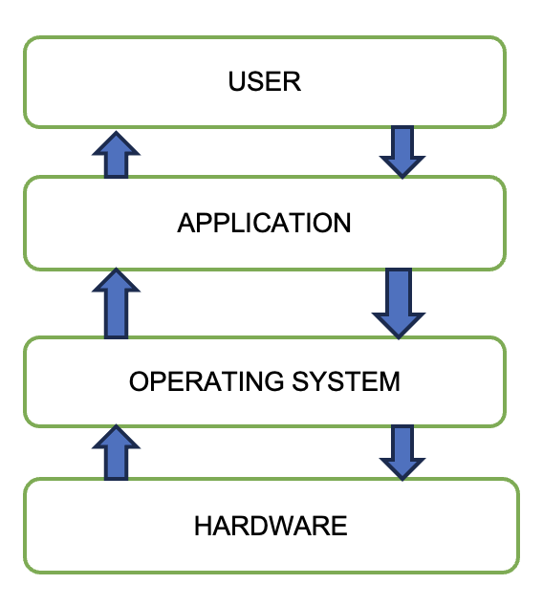
Flowchart Representation of OS

Slide 14
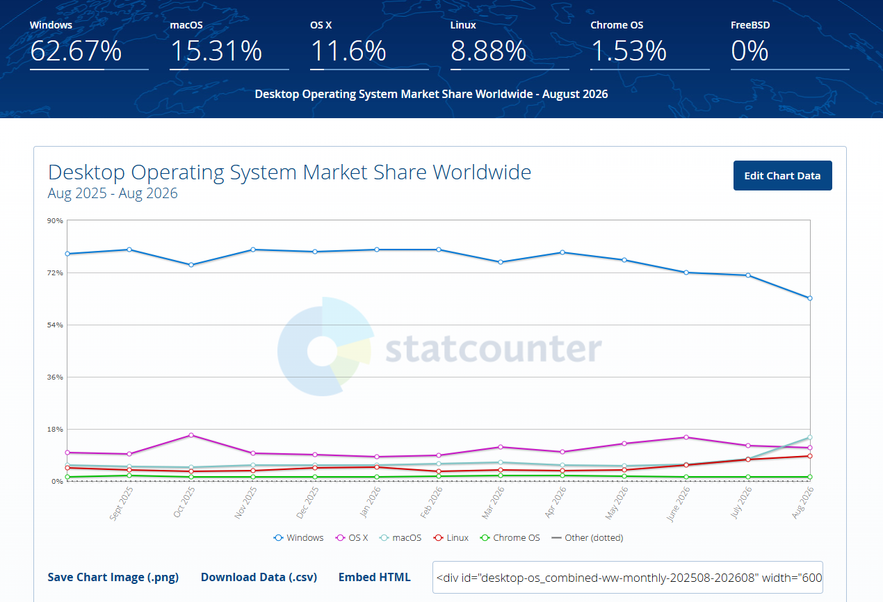
Desktop Operating Systems
Source: https://gs.statcounter.com/os-market-share/desktop/worldwide
Microsoft Windows:
- User-friendly, widespread, supports extensive range of software.
- Often pre-installed on many PCs.
Apple macOS:
- Known for sleek design, stability, strong integration with Apple hardware.
- Comes exclusively with Apple devices.
Linux:
- Open-source, free to download and modify.
- Highly flexible and used in servers, personal desktops, embedded systems.
Chrome
- Simple, just uses a web browser to access everything online.

Slide 15
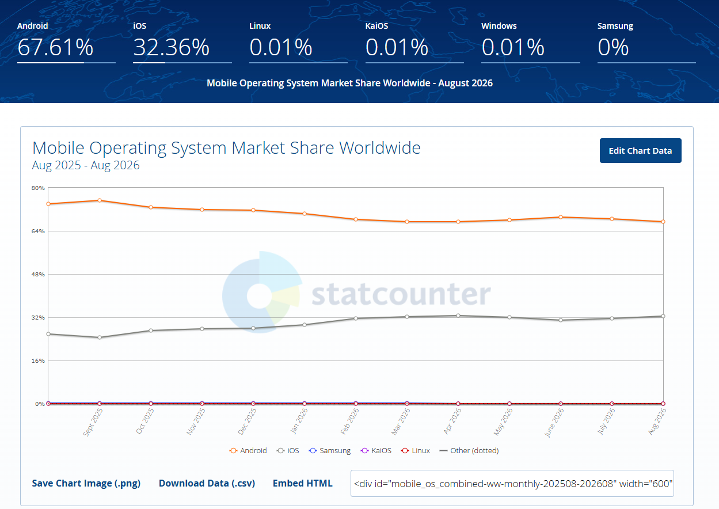
Phone Operating Systems
Source: https://gs.statcounter.com/os-market-share/mobile/worldwide
Your phone also runs an operating system.
iPhones and iPads run IOS
Android (Samsung Galaxy, Pixel, Xiaomi, Oppo, Vivo, Motorola etc.) phones run Android.
  Many cars, TVs, tablets, watches etc also run Android
  Android is a Linux distribution
Today more people use mobile operating systems than desktop, thus the answer to the question what is the most popular operating system, the answer is likely Android by far.

Slide 16
Microsoft Windows OS
Easiest for beginners due to extensive user-friendly features.
Large ecosystem of software (Microsoft Office, gaming, etc.).
Frequent updates (feature updates, security patches).
Common in both home and business environments.
Windows has been around since the mid-1980s and still remains popular.
System updates are very important for security.

Slide 17
Apple macOS
Built exclusively for Apple hardware (MacBook, iMac, Mac Mini).
Known for its robust performance with creative software (graphics, video editing).
Tight integration with Apple services (iCloud, iMessage, etc.).
Stable, consistent interface, but limited to Apple devices.
MacOS is Unix-based at its core, which aids stability and security.
Apple’s controlled hardware environment typically results in fewer driver or compatibility issues.

Slide 18
Linux based OS
It’s likely the computer you use for college runs Windows or MacOS.
Both are commercial products, and you paid for a license for your OS when you purchased your Laptop/Computer.
Linux is an alternative OS which is gaining popularity in desktop applications
  It’s free to use, you do not need to license it.
  There are many different distributions which are specialized for different workflows (e.g. if you are a video editor, there are distributions specialized for that purpose)
  It offers many open-source alternatives of popular software that you use which are free to use
Linux runs most of the server infrastructure in the world.
  Thus, it’s a good skill to have some understanding of if you wish to pursue any computing job.

Slide 19
Open-Source Software
Large groups of developers sometimes create products which are free to use as an alternative to paid ones.
  The Linux OS is an example of this.
Photoshop is a commercial (paid) application sold by Adobe. It’s probably the premier photo editing software, but it’s quite expensive.
  An opensource alternative is Gimp (GNU Image Manipulation Program). You can download it for free; it runs on windows and Linux.
    Of course it’s not 100% the same as Photoshop, some parts look different, some parts operate differently, but you can achieve similar results in both.
There are many opensource programs you should check-out and remember they exist so if you are ever stuck and need software you don’t own, there is likely an alternative that’s freely available.
  While they are all slightly different from their commercial counterparts, some are genuinely better than the commercial products.

Slide 20
Server Operating Systems
Most apps and programs you use on your phone rely on accessing information on the internet.
  What this means is that there is a “server” somewhere on the internet that your phone connects to.
  A server is just a computer running special software to answer those requests. Typically, one server can handle thousands of “clients” such as your app on your phone.
Servers and desktop computers have the same hardware, it’s just that servers tend to have more of it. While your desktop may have 4, 8 or 16GB of ram, a server may have 1024GB or maybe even 10240GB. Likewise, servers often have much more storage, since they handle more requests.
Today about 65% of all servers run Linux. Another 20% run other Unix operating systems. The remainder run windows.

Slide 21
Try out Linux
DO NOT install linux on your primary school computer to try it.
  Doing so would cause you to lose all your files
  It may also be difficult to go back to your original windows install
It is however possible to try linux so you can see what it’s like. The below link allows you to see a virtual machine running Linux inside your web browser
  Note a couple limitations:
    They are allowing you to run it for free, so it’s slow and limited. This doesn’t represent how it would work if you run it on your own hardware
    There is a queue to get access to a machine, depending on when you go to it, it may take a few minutes.
    What you get is a freshly installed OS, so it doesn’t have a lot of software installed by default.
    https://distrosea.com/
If you decide you like it, and have some old hardware laying around which you’d like to try it on:
  Backup all files you care about on the computer, otherwise you will lose them.
  Download the appropriate distro. If you don’t know which to start with, I’d recommend Ubuntu
  Install it, and see how it works.
You can also test it out in a virtual machine. Look into VirtualBox and similar software.

Slide 22
Summary
Purpose of an OS: Manages resources, provides an interface, and ensures security.
Examples: Windows, macOS, iOS, Android and Linux
Experiment Safely: If you want to try Linux, do so on a spare computer or in a virtual machine (e.g., VirtualBox, VMware).
Stay Updated: Regularly install updates to keep your OS secure and stable.

