Slide 1
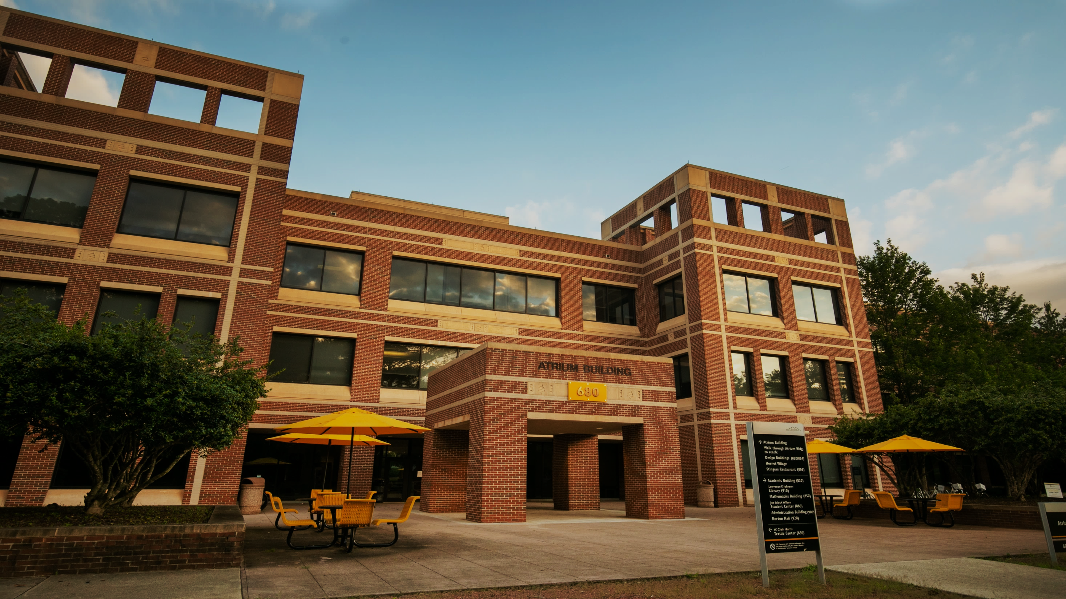

College of Computing and Software Engineering (CCSE)
CCSE Digital Policy and Online Course Development
November 30, 2022 10-11 am

Slide 2
Why Digital Policy
Offering online/hybrid courses provides flexibility for students and the programs. Additionally, online/hybrid course development creates an archive of course material that can help share expertise and resources across different sections and different semesters.

Slide 3
CCSE Digital Policy and Rubric
Faculty resources https://ccse.kennesaw.edu/faculty-resources/forms-documents.php
  Resources for Teaching Online
  Online/Hybrid Course Development (Policy, Rubric)
  Standards and Expectations for Faculty Teaching (Last approved 2/21/2022)

Slide 4

https://d2l.kennesaw.edu/
Important Announcements
Course Shell Requests
Third-party Integration Requests for D2L Brightspace
Course Reset Requests
Manual D2L Account Creation
Enroll 20+ Participants to D2L Course Shell

Slide 5
Other Resources
DLI website https://dli.kennesaw.edu/services/index.php
Template Course (aka master course) https://kennesaw.view.usg.edu/d2l/home/2810766 contact Veronica Bramlett vhitch@kennesaw.edu

Slide 6
Course Syllabi and Assessment (FCARs)
Why should we do it?
Who can help: Svetlana Peltsverger, Bill Forsyth, and Veronica Bramlett
Resources
  Faculty Course Assessment Reports (FCARs) https://ccse.kennesaw.edu/faculty-resources/forms-documents/fcars.php
  Instructions for D2L Competencies and Learning Outcomes https://ccse.kennesaw.edu/faculty-resources/forms-documents/d2l_for_fcars.php

Slide 7
Instructional Designers’ Topics
Accessibility
Assessments & Plagiarism Prevention
D2L Tools
Engagement & Instructor Presence
Instructional Technologies
Online Pedagogy
Other Challenges

Slide 8

Questions?

