Slide 1
Third-Party Application Accessibility
Good morning! We’ll get started right around ten.
Making Informed Decisions for Compliance

Slide 2

Third-Party Applications
How many different applications does your unit use to communicate, create and disseminate content, interact with students or other stakeholders, or manage files and/or processes?

Slide 3
Two considerations
Accessibility of the application itself
  Is the application optimized for people with disabilities to use?
Accessibility of the application’s output
  What does a user need to do to ensure they are using the application in the best way?

Slide 4
Two Tools to Determine App Accessibility
An Accessibility Statement
A Voluntary Product Accessibility Template (VPAT)

Slide 5
Accessibility Statements

Slide 6
An Accessibility Statement declares…
An entity’s (or an application’s) commitment to accessibility
The accessibility standards they follow
Where users can get help
It may also mention…
  Known limitations
  Technical prerequisites
  Measures taken for ongoing development

Slide 7
How Should I Use the Accessibility Statement?
If you haven’t purchased/decided to use the product, review for a sense of the vendor’s commitment. If they don’t have one, be wary!
For applications you already use, review the AS to learn how to get accessibility help for your users.
For any application that you use to interact with other users, publish the AS somewhere conspicuous so they know where to go for help!

Slide 8
Example Accessibility Statements
Adobe’s Accessibility Statement
Microsoft’s Accessibility Statement
Zoom Accessibility Statement
Any applications you’re curious about?
  How do I find an AS?
  go.kennesaw.edu/vpats

Slide 9
Voluntary Product Accessibility Templates
How to navigate the super-technical

Slide 10
What is it?
Where an AS is a broader document
  A VPAT is a more technical document reporting how a product conforms to all accessibility standards and is formatted according to a specific template.
  Usually formatted according to:
    WCAG (preferred due to regulation)
    Section 508 guidelines
Helps to be familiar with WCAG, so…here we go!

Slide 11
WCAG Breakdown
Web Content Accessibility Guidelines 2.1
4 Principles
13 Guidelines (examples)
3 Levels of Conformance
78 Success Criteria (example)
Perceivable
Operable
Understandable
Robust
1.1 Text alternatives
2.1 Keyboard Accessible
3.2 Predictable (logical structure)
4.1 Compatible
A
  Lowest, most essential, level
AA
  Mid-level and the required standard
AAA
  Highest level, often not measured
1.2.2 Captions (Prerecorded)
  Level A
  Captions are provided for all prerecorded audio content in synchronized media, except when the media is a media alternative for text….
Notes:
Review a few on 1.1-1.3.3

Slide 12
What is the Principle?
All functionality of the content is operable through a keyboard interface without requiring specific timings for individual keystrokes, except where the underlying function requires input that depends on the path of the user's movement and not just the endpoints.
Perceivable?
Operable?
Understandable?
Robust?
This is Success Criterion 2.1.1
Keyboard Level A

Slide 13
What is the Principle? (2)
The visual presentation of text and images of text has a contrast ratio of at least 4.5:1, except for the following:
  Large Text Large-scale text and images of large-scale text have a contrast ratio of at least 3:1;
Perceivable?
Operable?
Understandable?
Robust?
This is Success Criterion 1.4.3
Contrast Level AA

Slide 14
What is the Principle? (3)
Navigational mechanisms that are repeated on multiple web pages within a set of web pages occur in the same relative order each time they are repeated, unless a change is initiated by the user.
Perceivable?
Operable?
Understandable?
Robust?
This is Success Criterion 3.2.3
Consistent Navigation Level AA

Slide 15
What is the Principle (4)
In content implemented using markup languages, status messages can be programmatically determined through role or properties such that they can be presented to the user by assistive technologies without receiving focus.
Perceivable?
Operable?
Understandable?
Robust?
This is Success Criterion 4.1.3
Status Messages Level AA

Slide 16
What is the Principle (5)—Trickier!
Web pages do not contain anything that flashes more than three times in any one second period, or the flash is below the general flash and red flash thresholds.
Perceivable?
Operable?
Understandable?
Robust?
This is Success Criterion 2.3.1
Three Flashes or Below Threshold
Level A
Notes:
Note
Since any content that does not meet this success criterion can interfere with a user's ability to use the whole page, all content on the web page (whether it is used to meet other success criteria or not) must meet this success criterion. See Conformance Requirement 5: Non-Interference.

Slide 17
How Should I Use a VPAT?
If you haven’t purchased/decided to use the product, review to ensure that the product is compliant.
  A VPAT with several “does not support” ratings should probably be avoided altogether!
For applications you already use, review the VPAT to learn how best to use the application.
  Learn where your product does not support or partially supports so you can ensure you avoid using non-compliant features.
  Look for updates to VPATs!

Slide 18
Example VPATs
Articulate Rise VPAT
D2L VPAT
Any VPATs you’re curious about?
  How do I find a VPAT?
  go.kennesaw.edu/vpats
  Some are published, others have to be requested

Slide 19
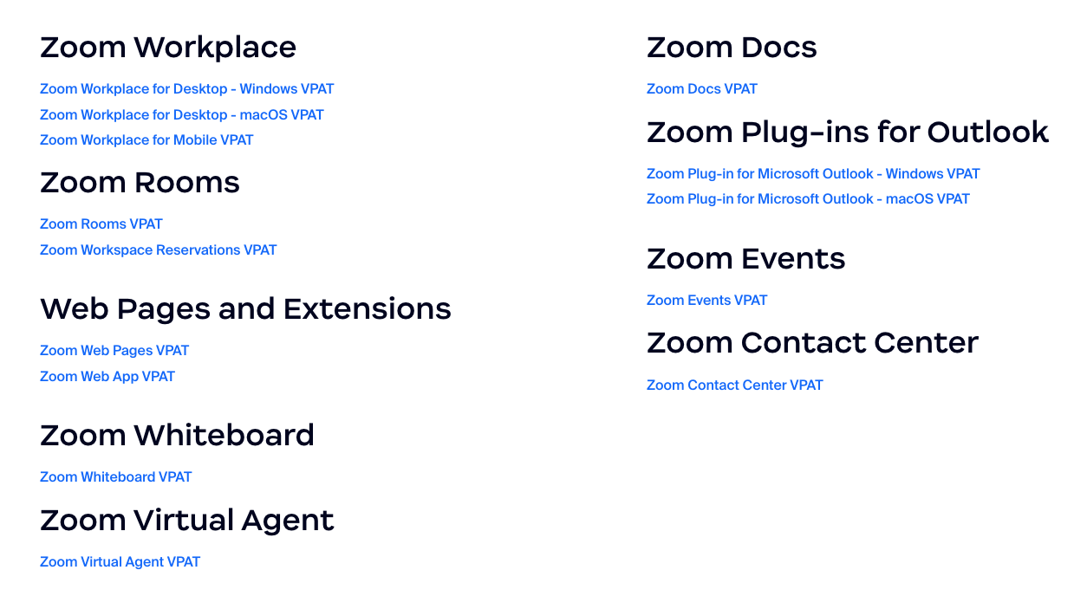
Keep in Mind
Some vendors will have multiple VPATs
  May put web version and mobile app on separate VPATs
  May have multiple applications with crossover
  May have versions for multiple operating systems or plugins

Slide 20
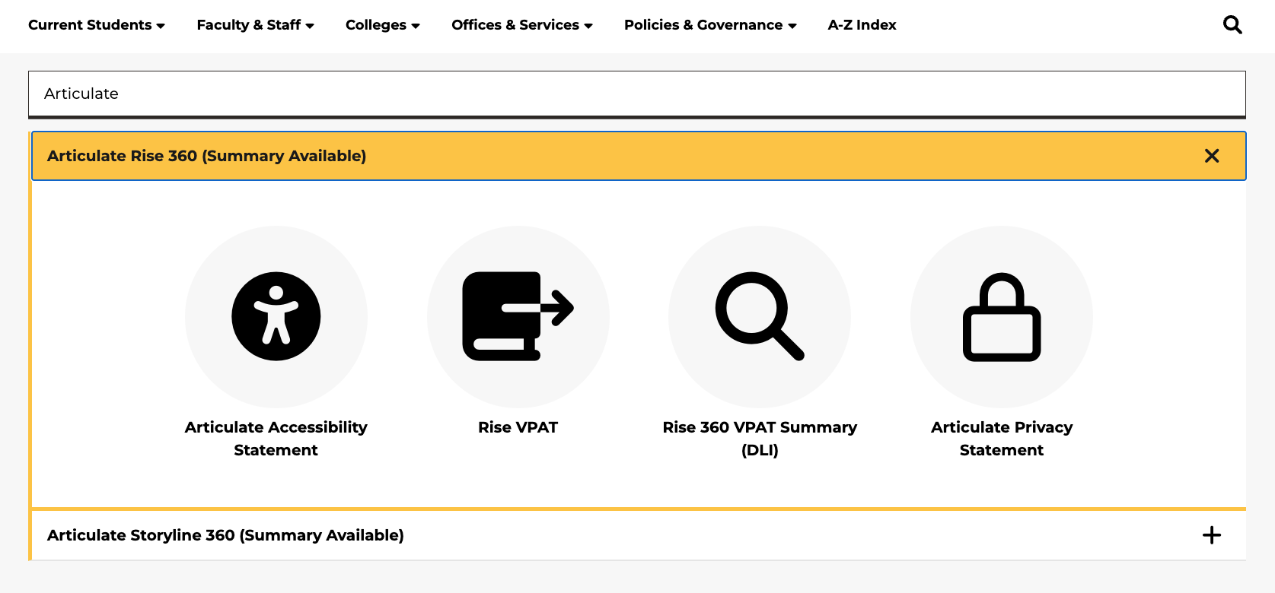
We Collect Accessibility Statements and VPATs
A searchable index is available for many common technologies at KSU.
Common Technology Statements and VPATs.
go.kennesaw.edu/vpats

Slide 21
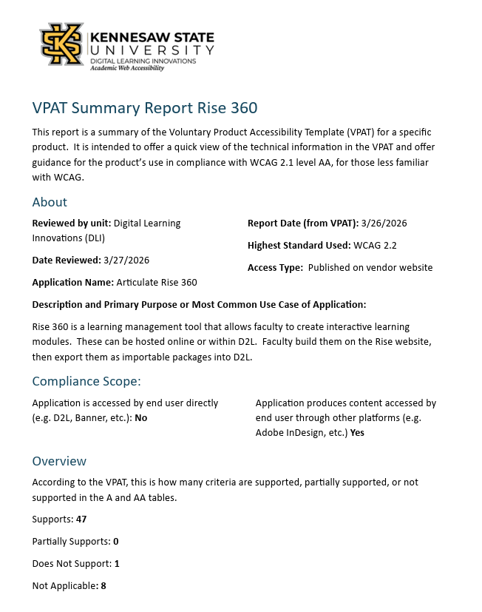
AWA VPAT Summaries
Academic Web Accessibility is providing VPAT summaries.
Common Technology Statements and VPATs.
go.kennesaw.edu/vpats

Slide 22
3rd Party Websites and Videos
What if I need to send someone off-site?

Slide 23
The sites we send people to need to be compliant, too!
We recommend the WAVE Accessibility Tool to check external websites for accessibility.
Sample pages to review:
  AWA Page
  CNN
  Arngren
  KSU Digital Maps
The WebAIM Million Report

Slide 24

Good News about YouTube Content
Faculty can use Kaltura MediaSpace to add captions to YouTube videos.

Slide 25
Resources
Accessibility Statements and VPATs
Common Technology Statements and VPATs
Accessibility Statements Microlearning
VPATs Microlearning

