Slide 1

Publishing:
Your Questions Answered
Publishing for Data Analytic Presentation by Heather Hankins and Chelsee Dickson is licensed under a Creative Commons Attribution 4.0 International License.
Notes:
Chelsee and Heather

Slide 2
Meet Your Speakers
Heather Hankins, Institutional Repository Supervisor
hhankin3@Kennesaw.edu
Chelsee Dickson, Scholarly Communications Librarian
cdickso5@Kennesaw.edu
Notes:
Heather talks first.
Then Chelsee.

Slide 3


Why are we here?
Notes:
Heather

Slide 4
Publishing as a Graduate Student
Grey Literature
  "everything else"
Formal Publications
  Journals, books, etc.
  Faculty mentor/coauthor
Notes:
Heather

Slide 5
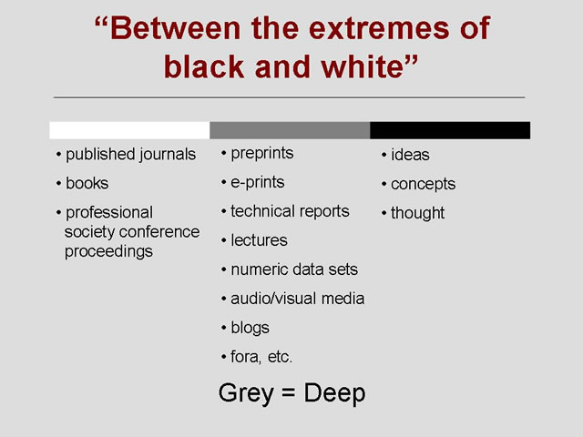
Grey
Literature
Notes:
Chelsee
Grey lit = "materials and research produced by organizations outside of the traditional commercial or academic publishing and distribution channels"
Can cite grey lit in your dissertation
Dissertations are considered grey lit

Slide 6

Evaluating Journals
Choices based on impact, altmetrics, and open access:
  How journals are recognized and perceived
  Citation counts
  Level of openness
Tools for evaluation:
  Web of Science Journal Citation Reports – citation data, rankings.
  UlrichsWeb – publishing frequency, peer review status.
  DOAJ – “online directory that indexes and provides access to high quality, open access, peer-reviewed journals.”
  Think.Check.Submit – checklist to assess journal/publisher credentials.

Slide 7

Fight for your (Author's) Rights!
Retain your intellectual property rights.
    YOU own the copyright initially
    Publisher may ask you to sign over most/all your rights
Read your author’s agreement carefully.
    Determines the rights you have over your work
    Use the SPARC Author Addendum
    Send it to the Scholarly Communications Librarian
Share your work while keeping control of it.
    Negotiate for the right to post and share copies
    Choose an Open Access publication
    Make your work available through a Creative Commons license
Notes:
Heather

Slide 8
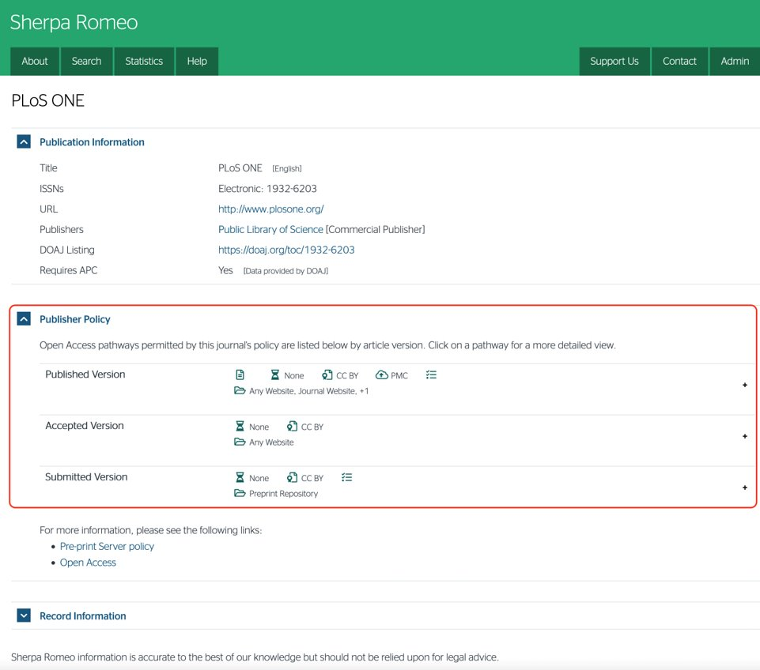
From Dissertations to Articles (and back again)
Three Article Dissertation or dissertation published as articles.
If your work has been published, cite yourself in your dissertation.
Sherpa Romeo lists journal copyright policies at https://v2.sherpa.ac.uk/romeo/
Notes:
Chelsee

Slide 9
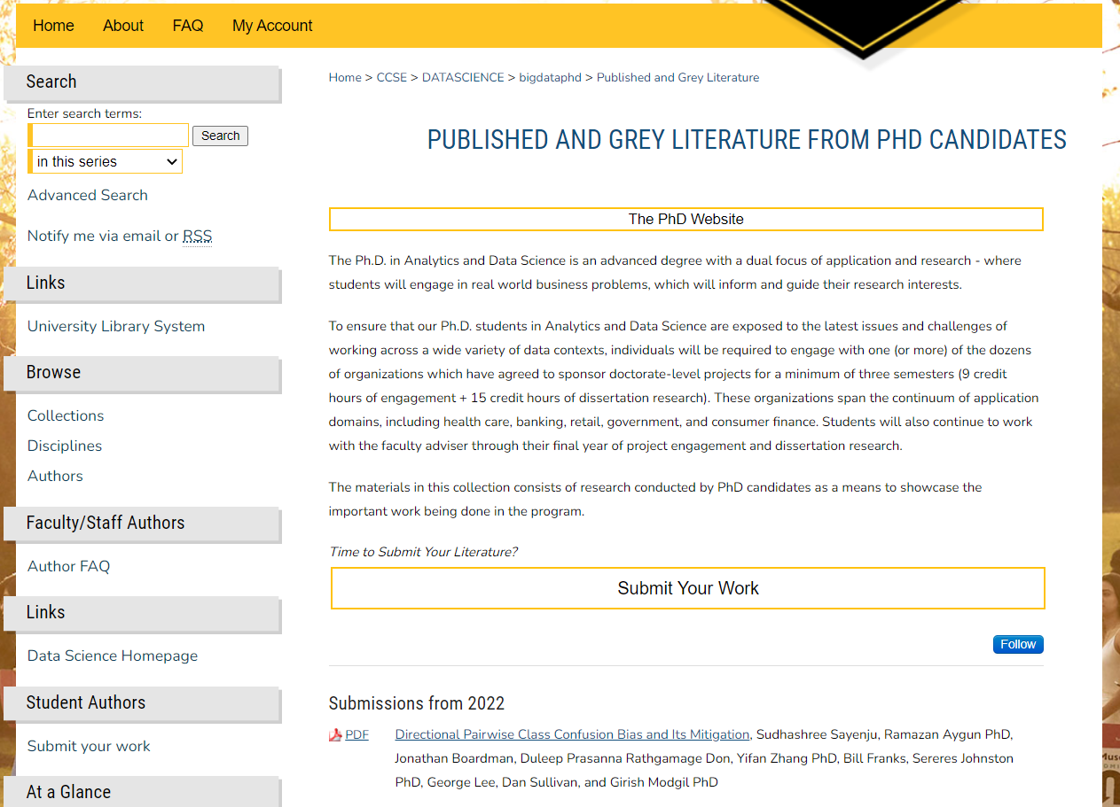
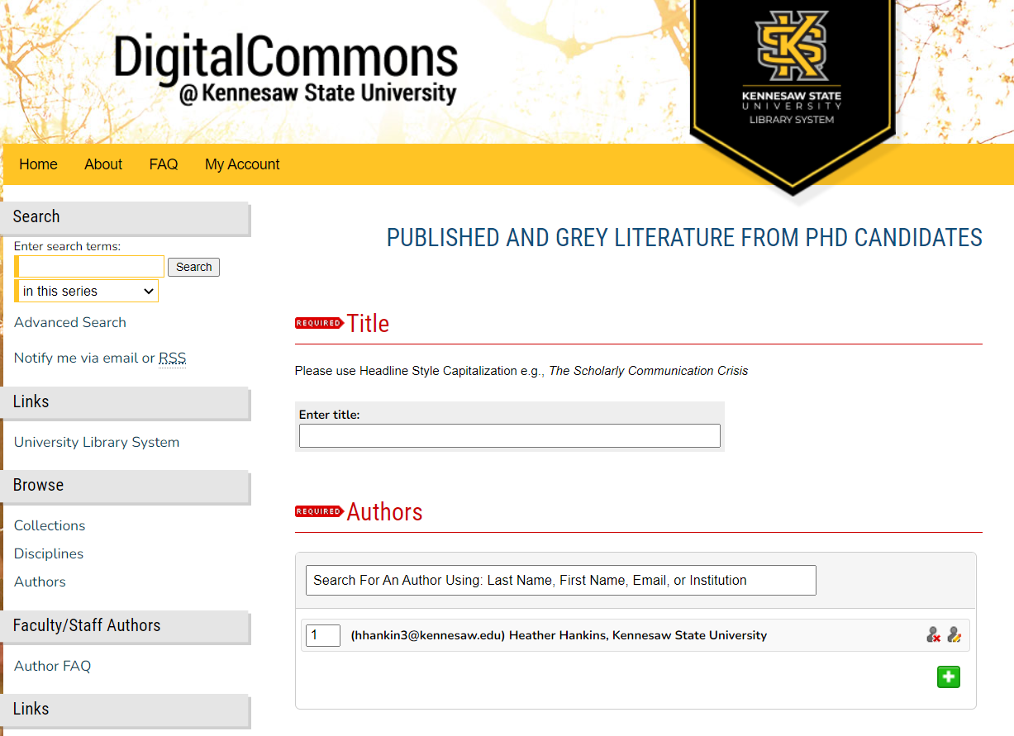
The Digital Commons@Kennesaw State University
Institutional repositories and their impact
URL: https://digitalcommons.kennesaw.edu/
Just for you: https://digitalcommons.kennesaw.edu/datascience/
Notes:
Heather

Slide 10

We want your datasets (please)
Open Data Movement
Open Data Licensing
Find existing datasets at https://digitalcommons.kennesaw.edu/datasets/
Notes:
Heather

Slide 11
Additional Resources
Analytics and Data Science Libguide
Directory of Open Access Journals (DOAJ)
SPARC Guide for Authors
Unpaywall extension
Notes:
Chelsee

Slide 12

Questions?
Publishing for Data Analytic Presentation by Heather Hankins and Chelsee Dickson is licensed under a Creative Commons Attribution 4.0 International License.
Notes:
Chelsee

