Slide 1

Analytics and Data Science Organization (ADSO)

Slide 2
Contents
ADSO Travel Support Funding Procedures
Instructions for submitting a SABAC Travel Support Funding Request
(titles are hyperlinked to specific sections of the PPT)
* All the slides are adapted from INCM Club travel funding procedure

Slide 3
ADSO Travel Support Funding Procedures

Slide 4
Travel Support Funding (Part I of III)
Students Activities Budget Advisory Committee (SABAC) funds students through registered organization of KSU
Student needs to be member of ADSO to claim travel funds
Annual potential maximum of up to $10,000 for Travel Support Funding per club
Travel support funding potential is up to $500 per student per trip (potential $750 exception for international travel)
Travel Support Funding only applies to:
a) hotel rooms
b) travel (airfare/rental car/parking fees)
c) registration fees
*no travel support for faculty/advisors
*Car Renting: Enterprise (GA), Hertz (outside of GA)
No AirBnBs or similar arrangements. Must be an officially licensed and franchised business.
*Must stay for more than 13 hours and be more than 50 miles from KSU to request Hotel.
* All the slides are adapted from INCM Club travel funding procedure

Slide 5
Travel support funding (Part II of III)
At least 21 days in advance to SABAC deadline
Travel to event after approval with personal money
After travel, fill ADSO Post-Travel form from OwlLife
Become a member of ADSO
Fill ADSO Pre-Travel form in OwlLife
Wait for ADSO approval
Submit documents and wait for approval
$$$
Need to finish with in 10 days after travel
Depends on SABAC meeting schedules

Slide 6
So for example…
If you submitted a pre-travel funding request before 12pm on September 16th
It will be reviewed on October 16th
It will take <= 10 business days for (possible) approval by VP of Students Affairs
Then it will take <= 10 business days for Business Operations Department to process the request.
Meaning funds could be released as earlier as October 18 or as late as November 13
* All the slides are adapted from INCM Club travel funding procedure

Slide 7
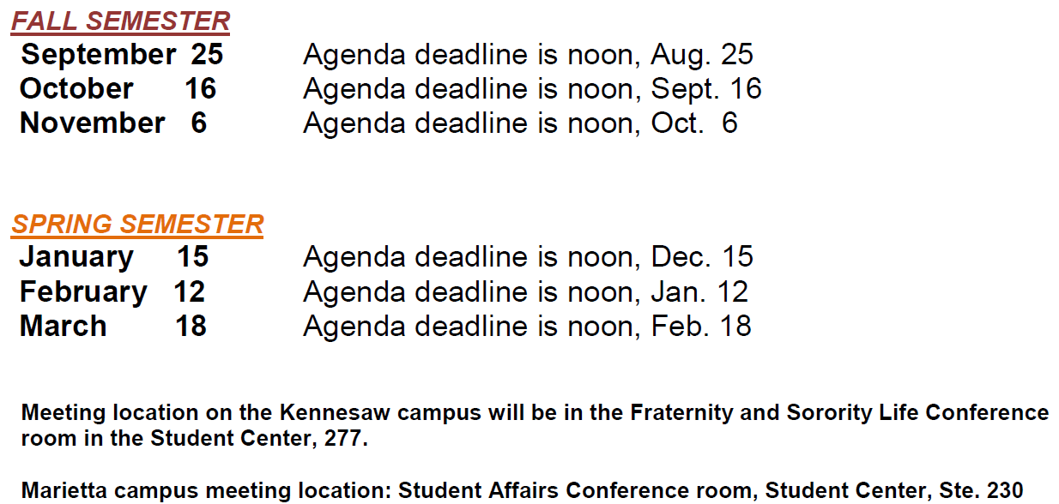
SABAC Supplemental Meeting Times for reimbursement
* All the slides are adapted from INCM Club travel funding procedure

Slide 8
Travel Support Funding (Part III of III)
What do you need to do?
Sign-up to be a member of the Analytics and Data Science Organization
Fill the ADSO Pre-Travel form in owl life. Submit the form to ADSO 3 weeks prior to SABAC agenda deadline.
Details of ADSO Pre-Travel form are given below:
Students details (KSU Id, email id, address, dept, program)
Travel information (Destination, Purpose of travel, Dates, mode of transportation, event date, estimation of budget, advisor’s details)
Sub-documents required to complete the form
Screenshot of proof of current Academic Enrollment (Get from DegreeWorks in Owlexpress)
Application Narrative (200-300 words) (Briefly explain Conference details, its importance for your research, benefit of attending, abstract of your research)
Trip Registration Form (Available at home page of ADSO organization in owl life)
ADSO team needs to approve the Pre-Travel form after verification of all required documents and information submitted by the student. If any more required document, team will contact the students. This approval needs to happen well before the student is scheduled to travel for the event. Notification of approval will be sent out, please get in touch with team regarding notification.
“Write and prepare your submission as if you were unable to be there in person to present it. Be thorough and concise.”
* All the slides are adapted from INCM Club travel funding procedure

Slide 9
submitting an ADSO Travel Support Funding Request

Slide 10
Steps in funding process
Students will come back to us after their event to follow up and fill the ADSO Post Travel form in owl life. Details of ADSO Pre-Travel form
Students details (KSU Id, email id, address, semester of travel)
Sub-documents required to complete the form
Vendor Registration Number (Use existing number or follow link to obtain new vendor number from Office of Fiscal Services) (form is also available to download from ADSO owl life)
KSU Travel Expense Form (form is also available to download from ADSO owl life)
Invitation, announcement and/or acceptance letter to conference or event
Conference agenda
Copy of the program page listing your name and presentation
A copy of your abstract (Share your experience at the conference)
If you are seeking for a Conference Registration Fee refund, please attach receipt/ conference registration confirmation here. Please note we do not refund for membership fees.
Please attach your mode of transportation with ticket confirmation and/or receipt. Make sure the TOTAL COST and YOUR name are both clearly shown.
If YES, please attach your Hotel Booking Confirmation. This must be in your name and show your name in the payment information. (PS: hotel booking below 50mile within Georgia is not considered for refund)
Please attach a copy of your Bank Statement highlighting the transactions you're looking to be reimbursed for. Please make sure to BLACK OUT all sensitive information. This document must clearly show your name. No third-party payments will be accepted.
Additional Payment Documentation (optional)

Slide 11
Important things to remember
ADSO team needs to approve the Post-Travel form after verification of all documents and information submitted by the student.
When the student receives “Notification of Approval”, we request the student to get in touch with the team for further process information.
ADSO team will forward the student submitted forms to SABAC.
The student will be notified based on the approval of SABAC for funding.
Mode of payment(bank credit, check etc) are handled as specified in the Vendor registration form by Office of Fiscal Services and refund will be credited to student.
ADSO team will keep students informed about the progress/status of application for travel funding.
ADSO Team may contact you if there is a requirement for addition documentation.

Slide 12
Few Reminders
Plan ahead and be very detailed and accurate with your travel support funding requests. The greater degree of documentation, the higher chance of receiving maximum funds.
Submit your requests for Travel Support Funding as early as possible.
SABAC Supplemental Funding is NOT an emergency/urgent funding mechanism. It is a designed to help give all Registered Student Organizations an opportunity to request additional funding for events that were not included in the Annual Budget programming due in March.

Slide 13
For any additional questions, contact ADSO Student Representative E-Mail: ADSO@KENNESAW.com

